Slide 2
WELCOME
By Sunil Upadhyay

Slide 3

Sentinel Secure
Safeguarding Networks With Wazuh guard

Slide 4

What is Wazuh ?
Wazuh is an open-source security platform used for threat detection, visibility, and compliance.
It provides intrusion detection, log analysis, file integrity monitoring, vulnerability detection, and security information and event management (SIEM) capabilities.
Wazuh helps organizations to monitor their IT environments, detect security threats in real-time, and respond effectively to cyber incidents.
It offers centralized logging and monitoring across diverse environments, including on-premises, cloud, and hybrid infrastructures.
By Sunil Upadhyay

Slide 5
Exploring the Advantages of Wazuh:
A Comprehensive Overview
01
02
03
Proxy Firewalls (Application Layer Firewalls):
Work at the application layer (Layer 7) of the OSI model.
Act as intermediaries between clients and servers, forwarding requests and responses.
Can provide deep packet inspection, content filtering, and more advanced security features.
Threat Detection and Response
Wazuh provides comprehensive threat detection capabilities, allowing organizations to monitor their IT environments for security threats in real-time.
It detects suspicious activities, malware, and potential security breaches, enabling quick response and mitigation.
Stateful Inspection Firewalls:
Also known as dynamic packet filtering firewalls.
Keep track of the state of active connections and make decisions based on the context of the traffic.
Offers improved security over packet filtering firewalls.
By Sunil Upadhyay

Slide 6
Exploring the Advantages of Wazuh:
A Comprehensive Overview
01
02
03
Proxy Firewalls (Application Layer Firewalls):
Work at the application layer (Layer 7) of the OSI model.
Act as intermediaries between clients and servers, forwarding requests and responses.
Can provide deep packet inspection, content filtering, and more advanced security features.
Threat Detection and Response
Wazuh provides comprehensive threat detection capabilities, allowing organizations to monitor their IT environments for security threats in real-time.
It detects suspicious activities, malware, and potential security breaches, enabling quick response and mitigation.
Scalability and Flexibility
Wazuh is highly scalable and adaptable to various environments, including on-premises, cloud, and hybrid infrastructures.
It can be easily integrated with existing security tools and technologies, providing flexibility in deployment and management.
By Sunil Upadhyay

Slide 7
Exploring the Advantages of Wazuh:
A Comprehensive Overview
01
02
03
Cost-Effective Security Solution
As an open-source solution, Wazuh eliminates the need for costly licensing fees associated with proprietary security tools.
Organizations can deploy Wazuh at scale without incurring additional expenses, making it a cost-effective choice for enhancing security posture and compliance.
Threat Detection and Response
Wazuh provides comprehensive threat detection capabilities, allowing organizations to monitor their IT environments for security threats in real-time.
It detects suspicious activities, malware, and potential security breaches, enabling quick response and mitigation.
Scalability and Flexibility
Wazuh is highly scalable and adaptable to various environments, including on-premises, cloud, and hybrid infrastructures.
It can be easily integrated with existing security tools and technologies, providing flexibility in deployment and management.
By Sunil Upadhyay

Slide 8

There are numerous companies that offer such types of services.
Elastic
Splunk
LogRhythm
IBM Security
SolarWinds
McAfee
AlienVault
By Sunil Upadhyay

Slide 9
Wazuh Manager
Wazuh Agent
The Wazuh manager is a key component of the Wazuh platform, responsible for centralized management and coordination of security monitoring activities.
It collects and analyzes data from Wazuh agents deployed across an environment, processes security events, and provides centralized visibility and control.
The manager also facilitates alerting, logging, and reporting functionalities
The Wazuh agent is a lightweight software component installed on endpoints within a network to monitor security events and collect relevant data.
It works by continuously gathering information about system activity, such as log files, configurations, and system calls.
The agent then forwards this data to the Wazuh manager for analysis and centralized monitoring.
By Sunil Upadhyay

Slide 10
Wazuh Agent
Wazuh Manager
Wazuh Agent
The Wazuh manager is a key component of the Wazuh platform, responsible for centralized management and coordination of security monitoring activities.
It collects and analyzes data from Wazuh agents deployed across an environment, processes security events, and provides centralized visibility and control.
The manager also facilitates alerting, logging, and reporting functionalities
The Wazuh agent is a lightweight software component installed on endpoints within a network to monitor security events and collect relevant data.
It works by continuously gathering information about system activity, such as log files, configurations, and system calls.
The agent then forwards this data to the Wazuh manager for analysis and centralized monitoring.
The Wazuh agent is a lightweight software component installed on endpoints within a network to monitor security events and collect relevant data.
It works by continuously gathering information about system activity, such as log files, configurations, and system calls.
The agent then forwards this data to the Wazuh manager for analysis and centralized monitoring.
By Sunil Upadhyay

Slide 11

Let's get into the complexities of the Wazuh.
By Sunil Upadhyay

Slide 12

Cource Content
1. Essential Services in the Wazuh Ecosystem
2. Installation and Deployment Process
3. Secure Communication Channels
4. Holistic Threat Monitoring and Response.
5. Integrity Monitoring and Assurance
6. Comprehensive System Auditing.
7. Enhanced Email Security
8. Real-Time Alerting
10. Efficient Resource Utilization Monitoring
9. Automated Health Monitoring of Wazuh Infrastructure
By Sunil Upadhyay

Slide 13
Essential Services in the Wazuh Ecosystem :
Elasticsearch: It is used for storing, searching, and analyzing large volumes of structured or unstructured data in real-time. Elasticsearch serves as the core component of the Elastic Stack, providing the underlying storage and search functionality for Kibana and other Elastic Stack components.
Filebeat: Filebeat is a lightweight data shipper for forwarding log files to Elasticsearch or Logstash for indexing and analysis. It is part of the Elastic Stack (ELK Stack) and is used to collect log events from files on remote machines.
Kibana: Kibana is an open-source data visualization dashboard for Elasticsearch. With Kibana, users can create various types of visualizations, such as line charts, bar charts, pie charts, and maps, to gain insights into their data.
By Sunil Upadhyay

Slide 14
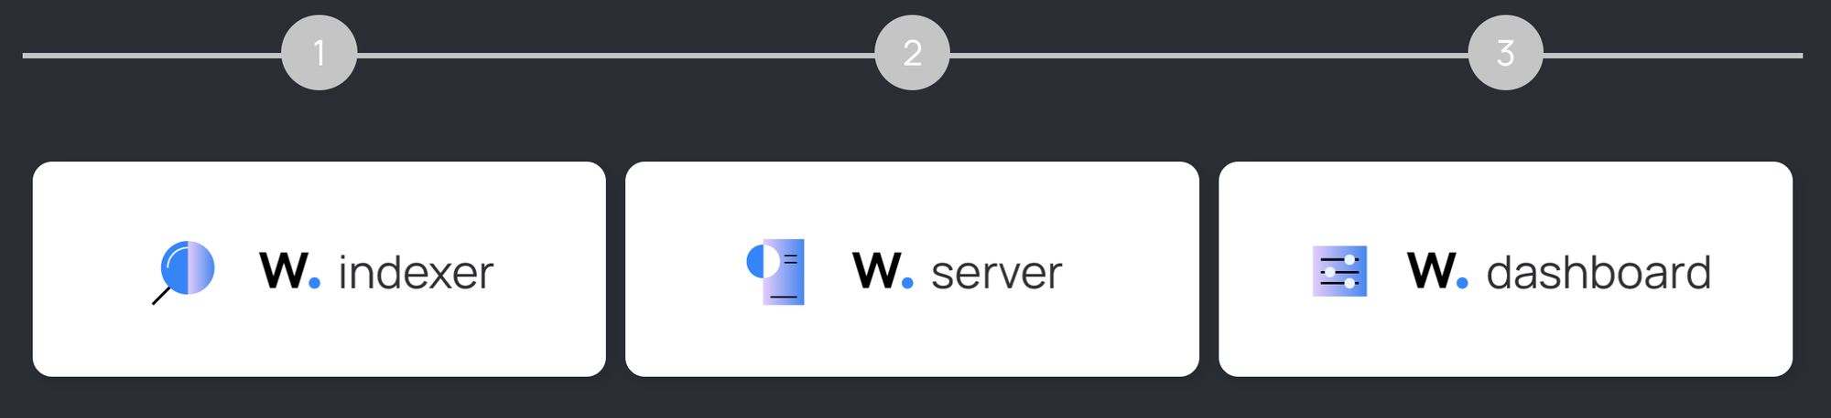
Installation guide Of Wazuh
Wazuh is a security platform that provides unified XDR and SIEM protection for endpoints and cloud workloads.
The solution is composed of a single universal agent and three central components: the Wazuh server, the Wazuh indexer, and the Wazuh dashboard.
This is the installation workflow you will follow:
By Sunil Upadhyay

Slide 15
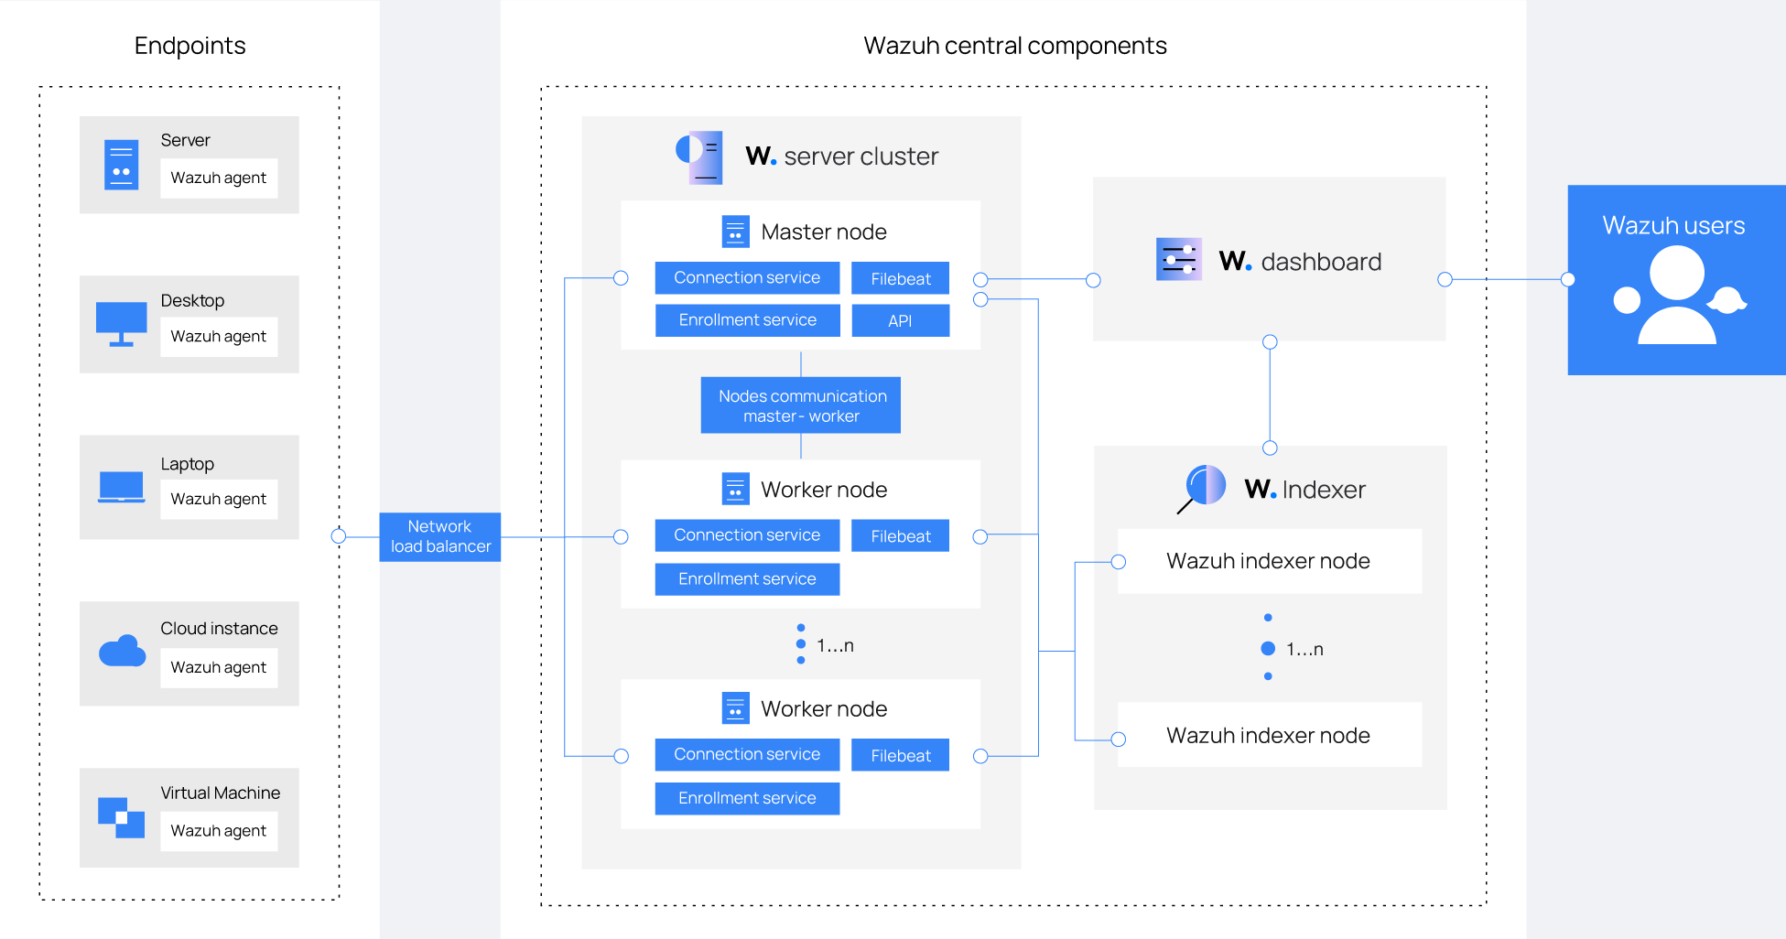
Let’s Go Through three tier Installation of Wazuh
By Sunil Upadhyay

Slide 16
Wazuh Indexer
The Wazuh indexer is a highly scalable, full-text search and analytics engine.
This Wazuh central component indexes and stores alerts generated by the Wazuh server and provides near real-time data search and analytics capabilities.
You can install the Wazuh indexer on a single host. Alternatively, you can install it distributed in multiple nodes, in a cluster configuration. This provides scalability, high availability, and improved performance.
Step-by-step installation: Install this component following detailed step-by-step instructions.
The installation process is divided into three stages.
Certificates creation
Nodes installation
Cluster initialization
Note : You need root user privileges to run all the commands described below.
By Sunil Upadhyay

Slide 17
Wazuh Server
The Wazuh server analyzes the data received from the Wazuh agents, triggering alerts when threats or anomalies are detected.
It is also used to remotely manage the agents' configuration and monitor their status.
You can install the Wazuh server on a single host. Alternatively, you can install it distributed in multiple nodes in a cluster configuration.
Multi-node configurations provide high availability and improved performance.
And if combined with a network load balancer an efficient use of its capacity can be achieved.
The Wazuh server is a central component that includes the Wazuh manager and Filebeat.
The Wazuh manager collects and analyzes data from the deployed Wazuh agents.
It triggers alerts when threats or anomalies are detected.
Filebeat securely forwards alerts and archived events to the Wazuh indexer.
Step-by-step installation: Install this component following detailed step-by-step instructions.
By Sunil Upadhyay

Slide 18
Wazuh Dashboard
This central component is a flexible and intuitive web interface for mining, analyzing, and visualizing security data.
It provides out-of-the-box dashboards, allowing you to seamlessly navigate through the user interface.
With the Wazuh dashboard, users can visualize security events, detected vulnerabilities, file integrity monitoring data, configuration assessment results, cloud infrastructure monitoring events, and regulatory compliance standards.
The dashboard gives a high-level summary of security alerts, system status, and other important metrics. Users can quickly assess the overall security posture of their environment.
Users can customize the dashboard layout and content according to their specific requirements. They can add or remove widgets, adjust time ranges, and filter data to focus on specific areas of interest.
Step-by-step installation: Install this component following detailed step-by-step instructions.
By Sunil Upadhyay

Slide 19
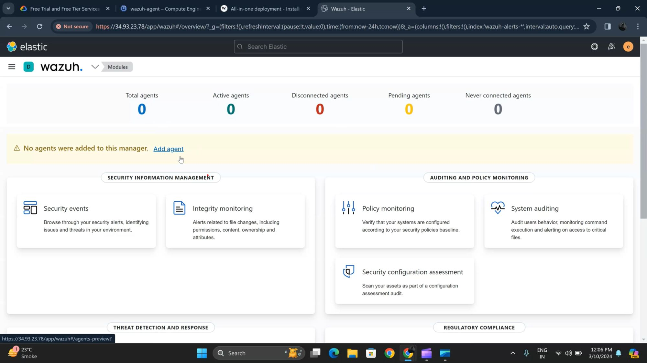
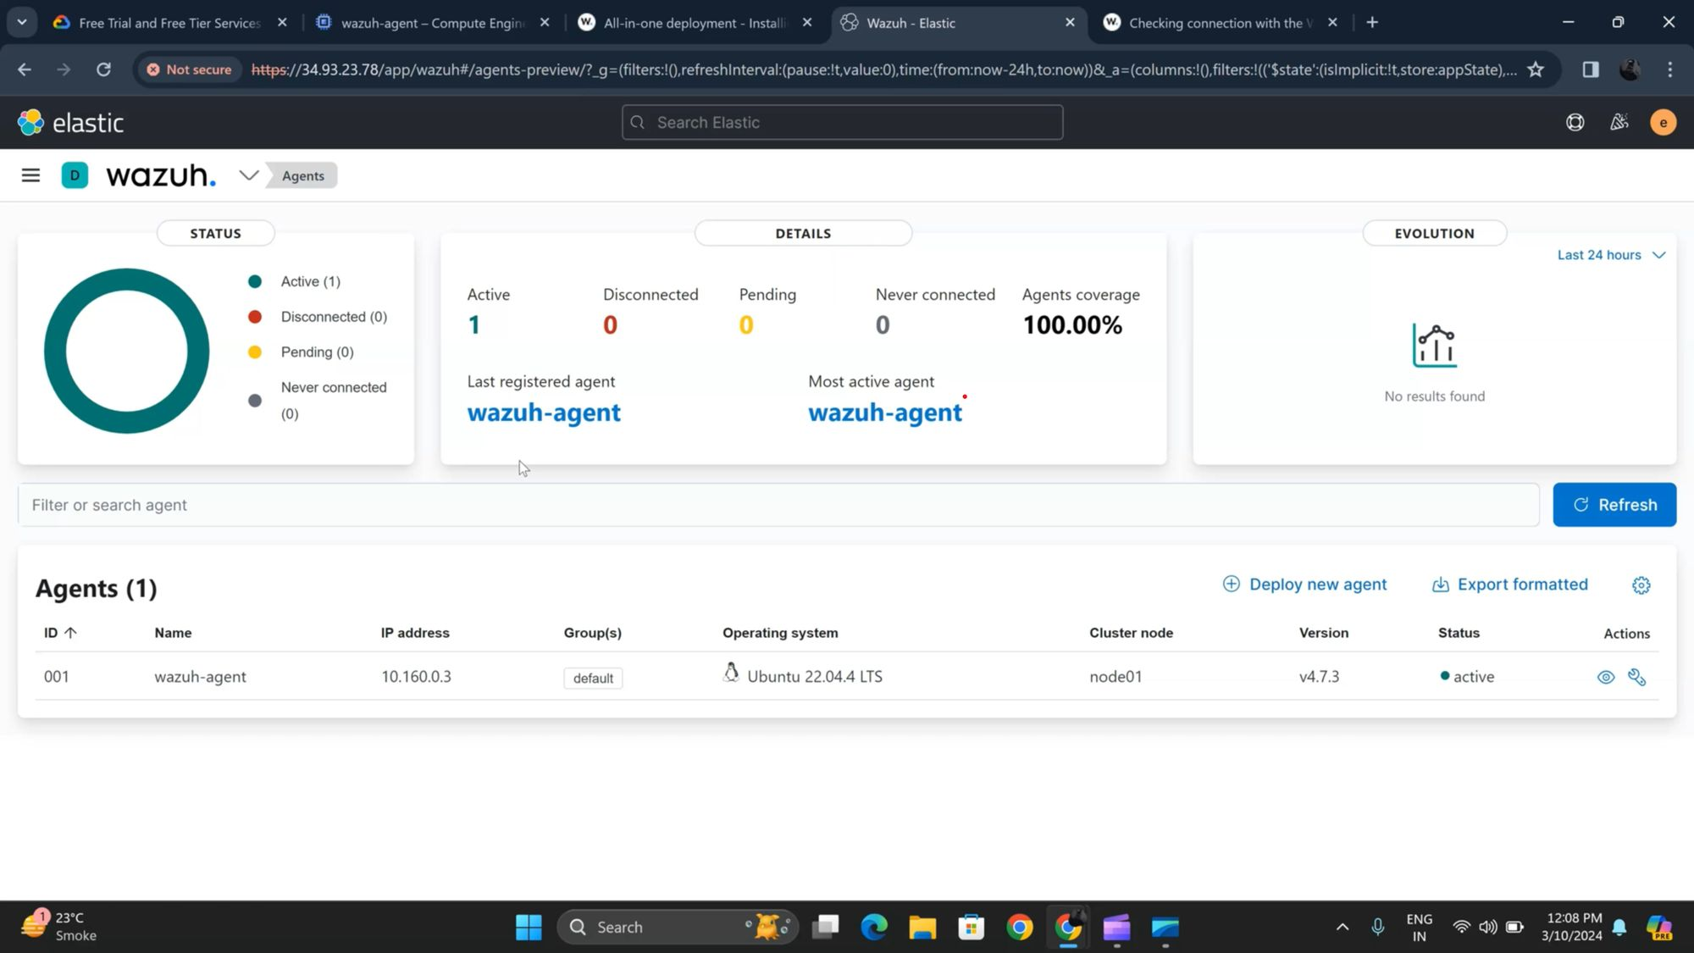
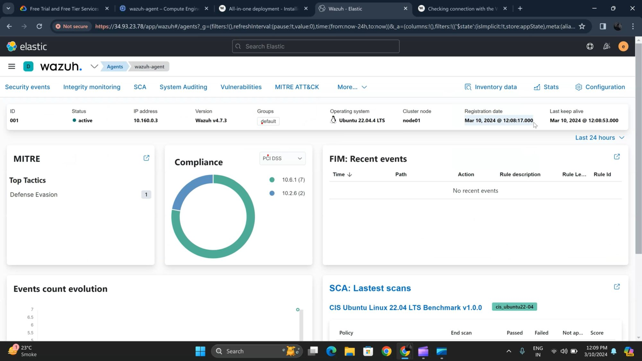
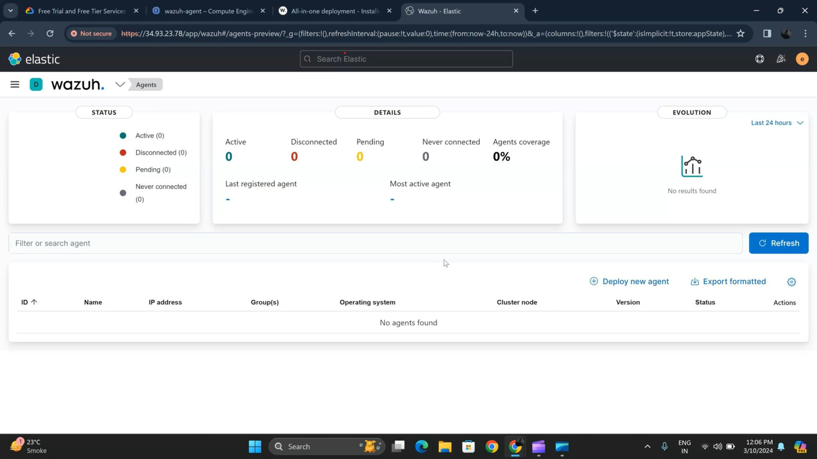
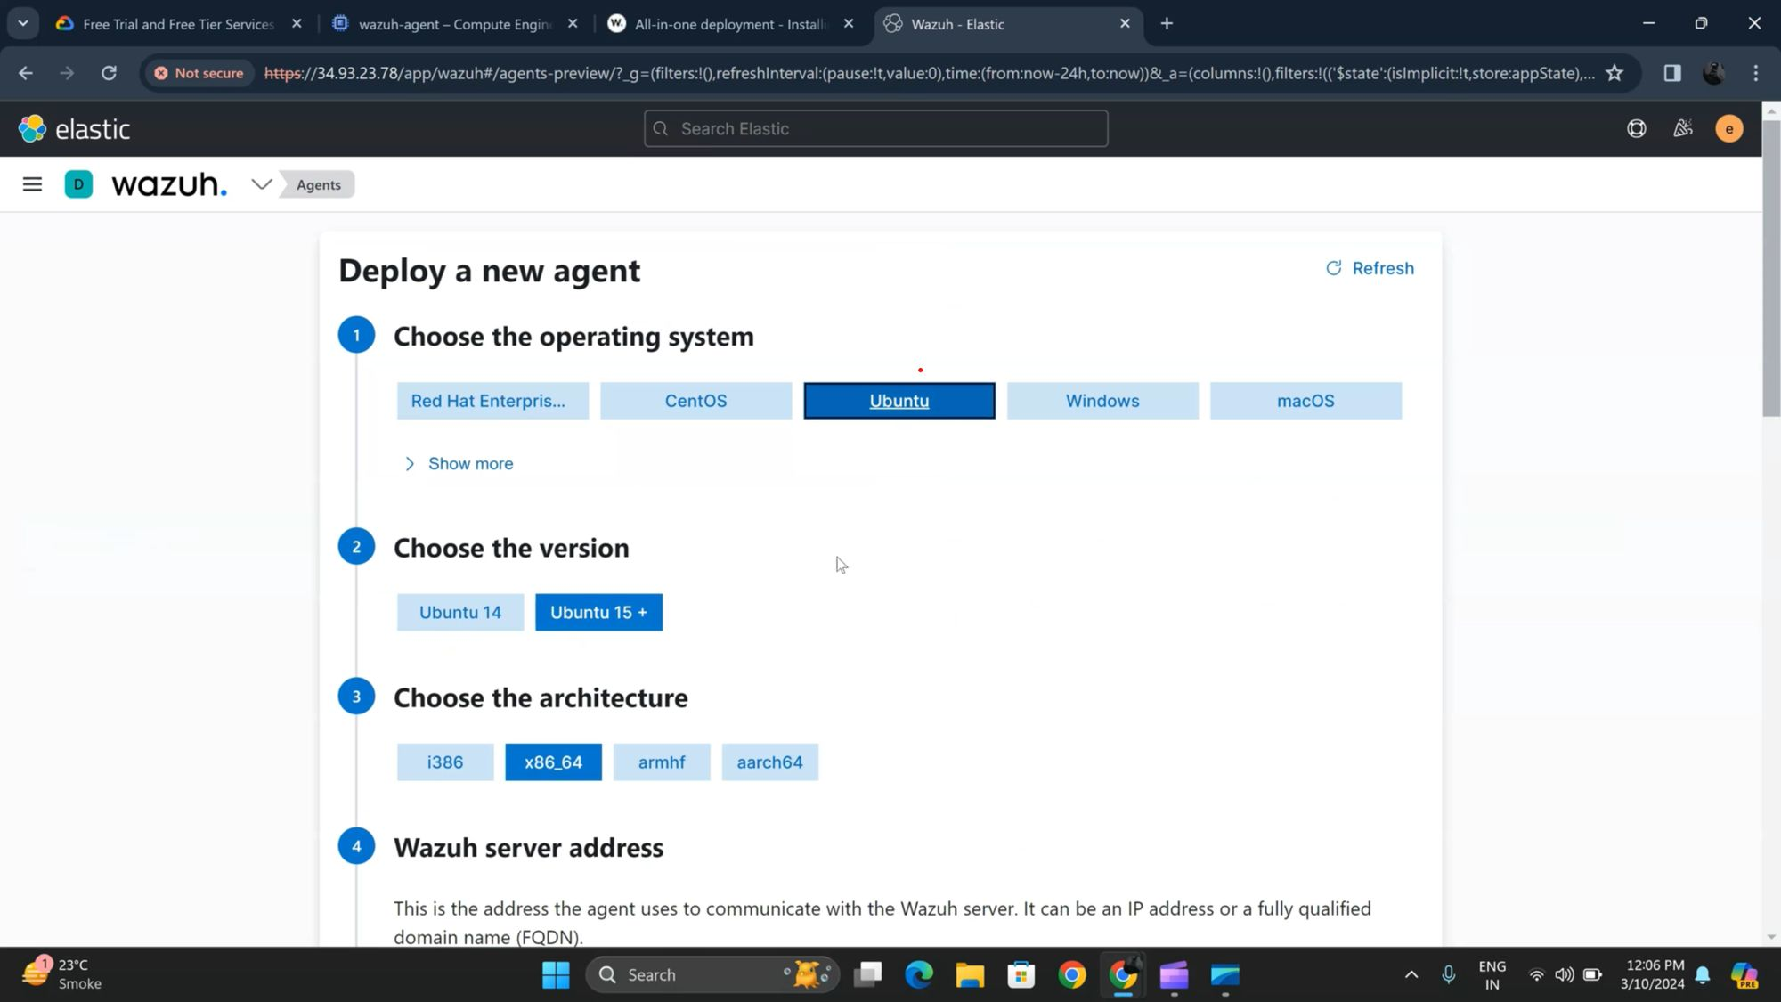
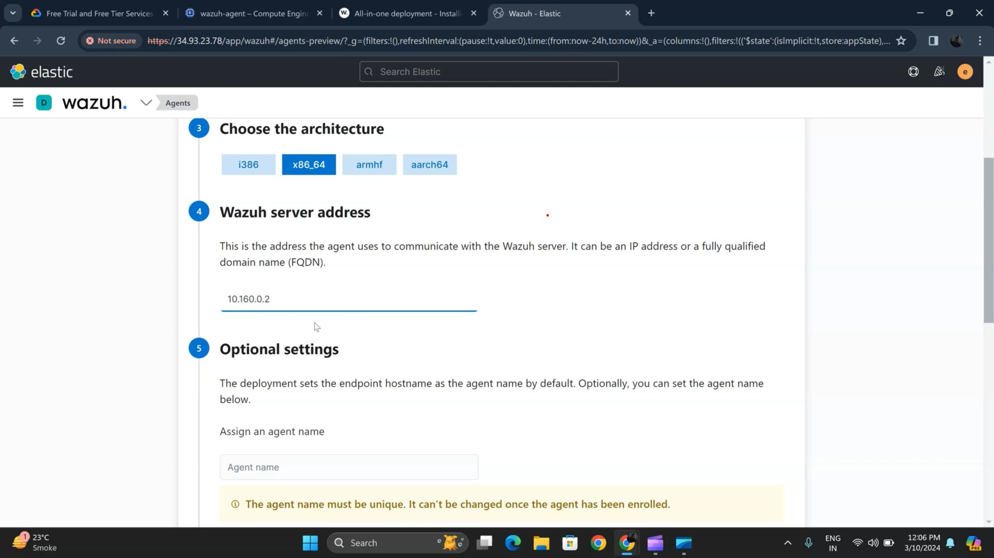
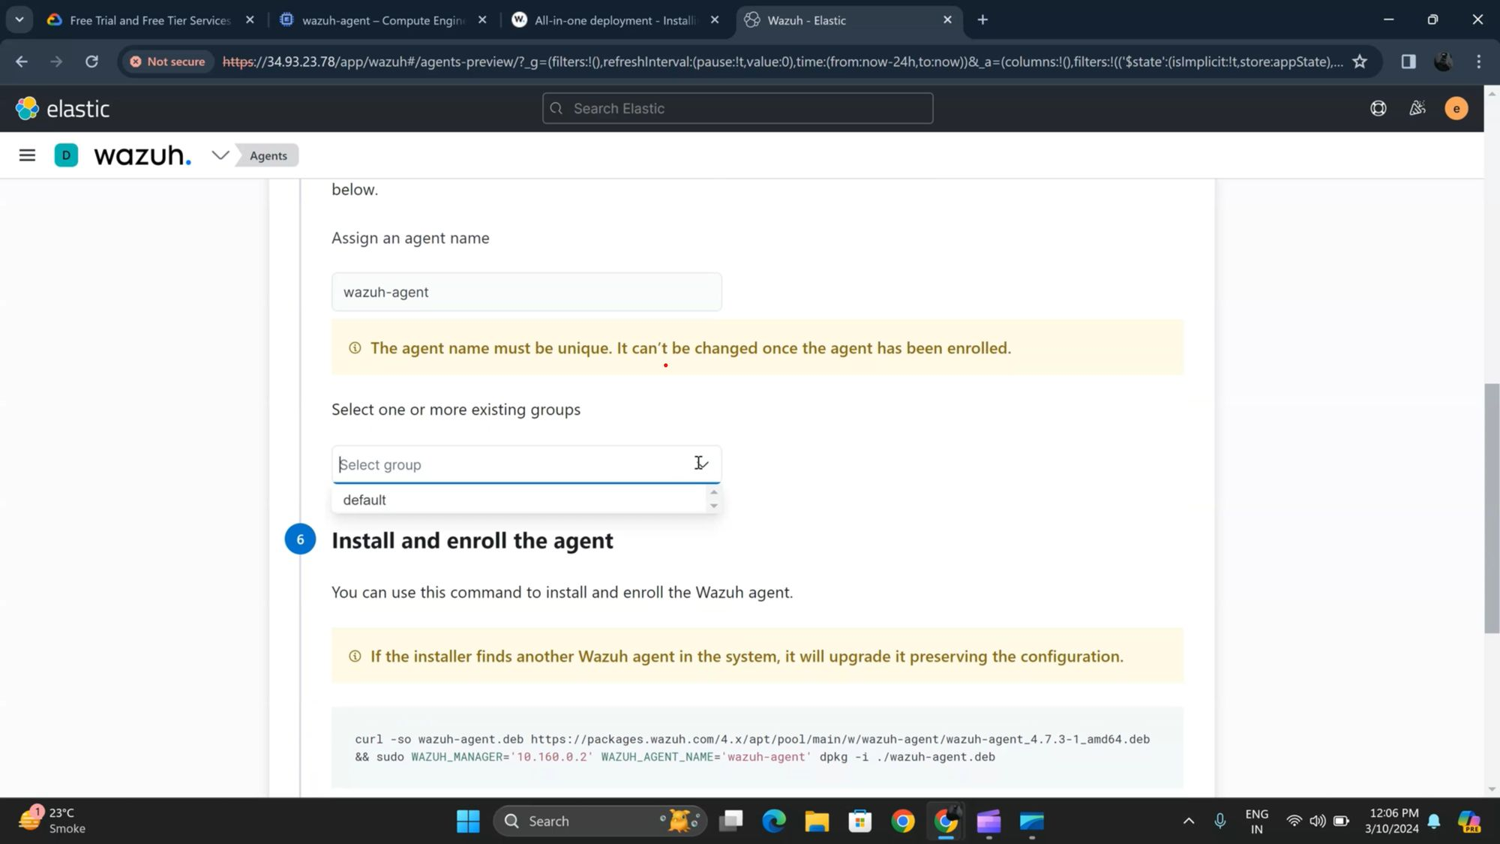
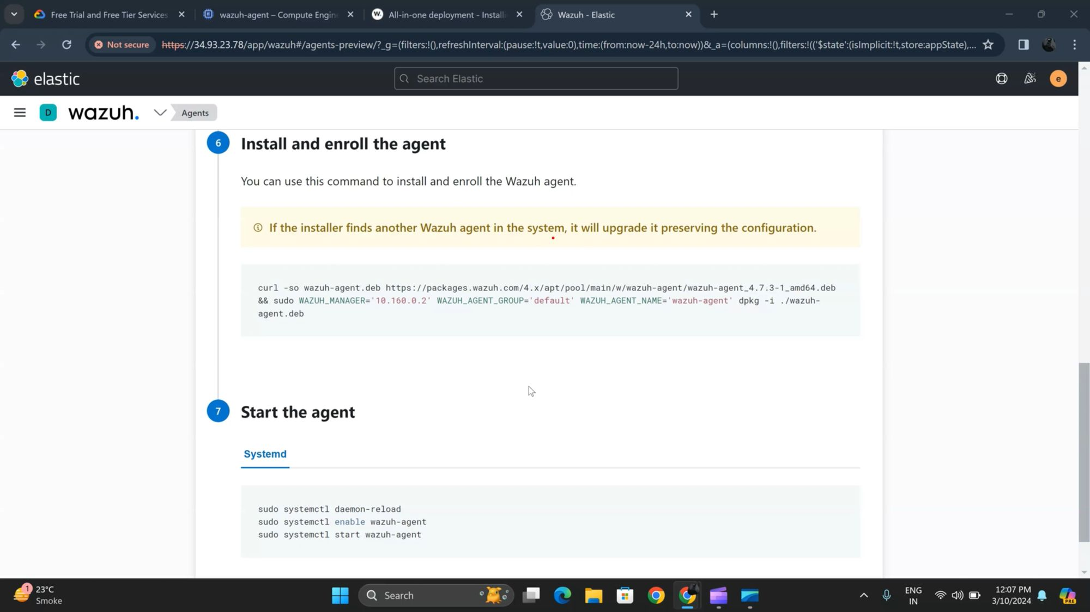
Secure Communication Channels
So after setting up wazuh go to the wazuh dashboard here you can see we have currently 0 active agents so we are going to add our first agent which is ubuntu agent
So just simply click on add agent and move further next step
Step 1
By Sunil Upadhyay

Slide 20
Secure Communication Channels
After entering this new wizard you can see there is an option of deploy a new agent just simply click on that and move forward.
Step 2
By Sunil Upadhyay

Slide 21
Secure Communication Channels
Here first of all we have to select the operating system which we have used Ubuntu.
Then second step is to select the version of the operating system our is 22 so we are selecting 15+
And third option is choose the architecture so our architecture is 64 bit.
Step 3
By Sunil Upadhyay

Slide 22
Secure Communication Channels
Now we have to give the ip address of our wazuh server so just go into the wazuh cli mode and do ifconfig and copy paste the ip.
Give the agent name which we have wazuh-agent
Step 4
By Sunil Upadhyay

Slide 23
Secure Communication Channels
Next step is to select the group which we are selecting by default.
Step 5
By Sunil Upadhyay

Slide 24
Secure Communication Channels
Our last and final step is to just copy this commands which are shown in the picture and run into the wazuh agent.
You have nothing to do just simply copy it from here and paste in the wazuh agent cli mode.
Step 6
By Sunil Upadhyay

Slide 25
Secure Communication Channels
And Here we go our wazuh-agent is active and added to the wazuh manager.
In the second picture you can also see the details of your operating system.
Just like that you can also add windows and other operating system as an agent in wazuh.
Step 7
By Sunil Upadhyay

Slide 26
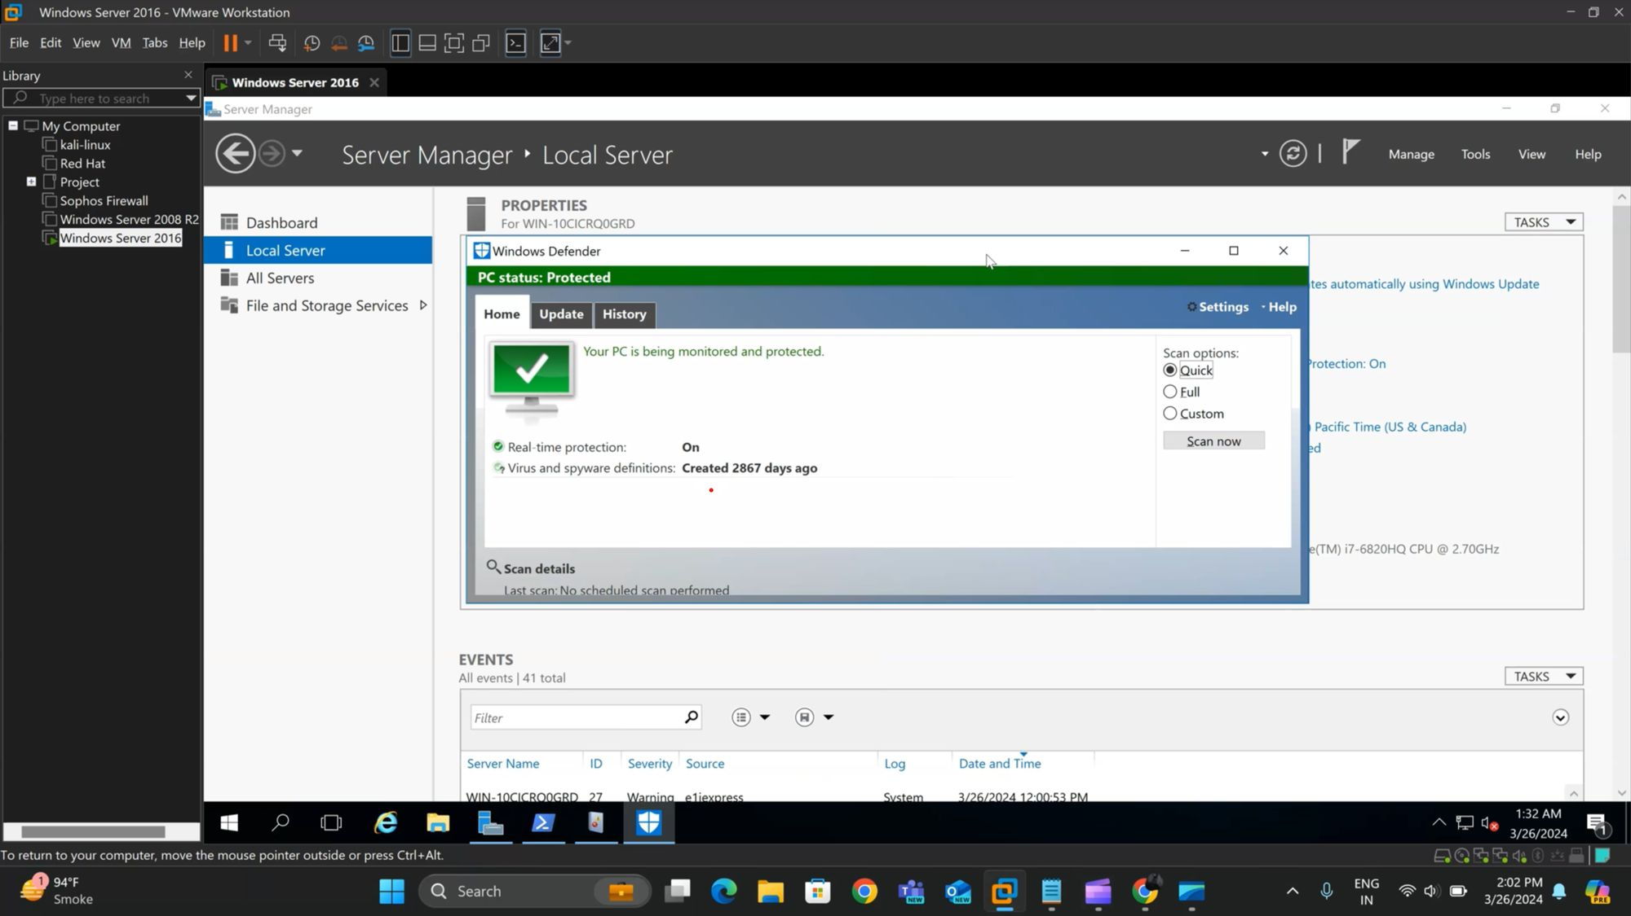
Holistic Threat Monitoring and Response
windows defender which comes pre-installed with all windows operating systems uh and of course is free and in my opinion is a pretty good anti-virus uh solution
you know it's it still contains a lot of these signature sets that a lot of these commercial anti-virus solutions uh use.
it also outputs to a windows event log so that we can actually now tell our wazoo agent that's running on all of our windows boxes say hey when this particular event log is seen let's go ahead and send it to wazoo.
all right so the first thing to do is make sure that windows defender is of course running and has the real-time protection set to enabled to open this gui you can just do it within it's probably with the windows button and search it with windows defender and it will shown to you.
By Sunil Upadhyay

Slide 27
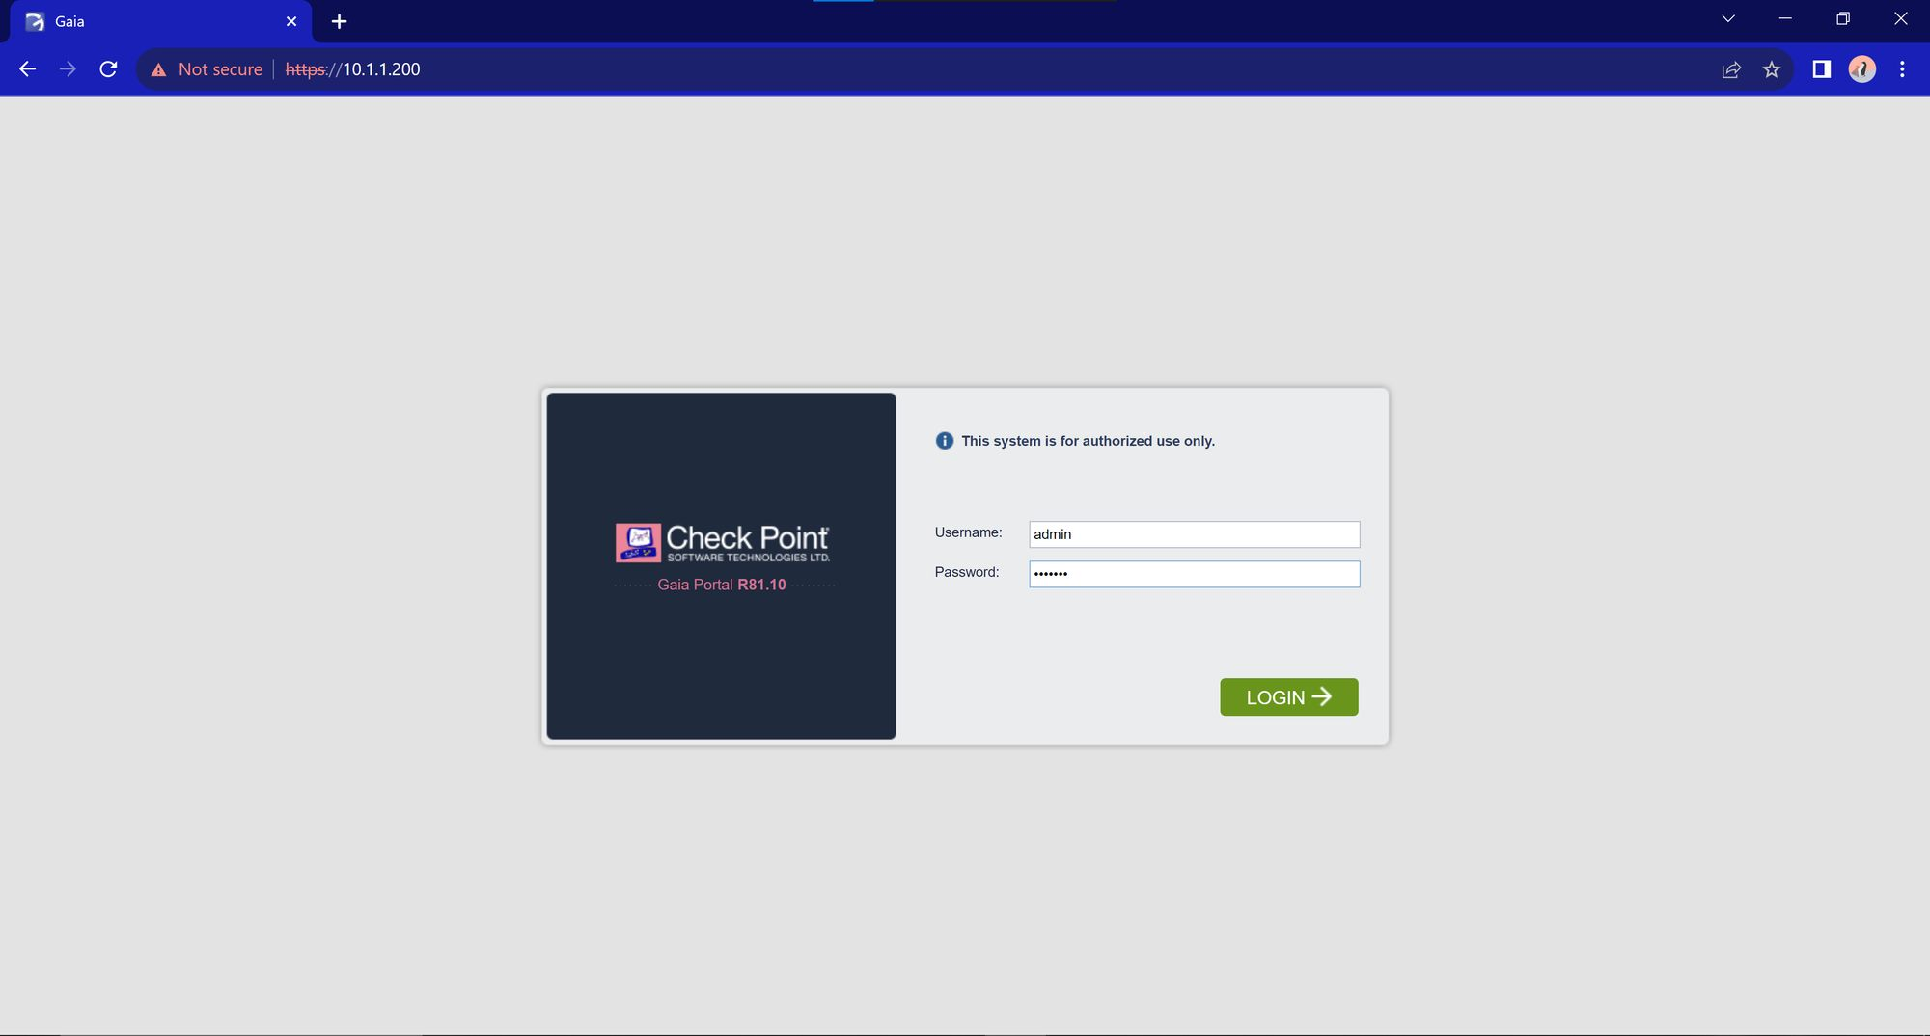
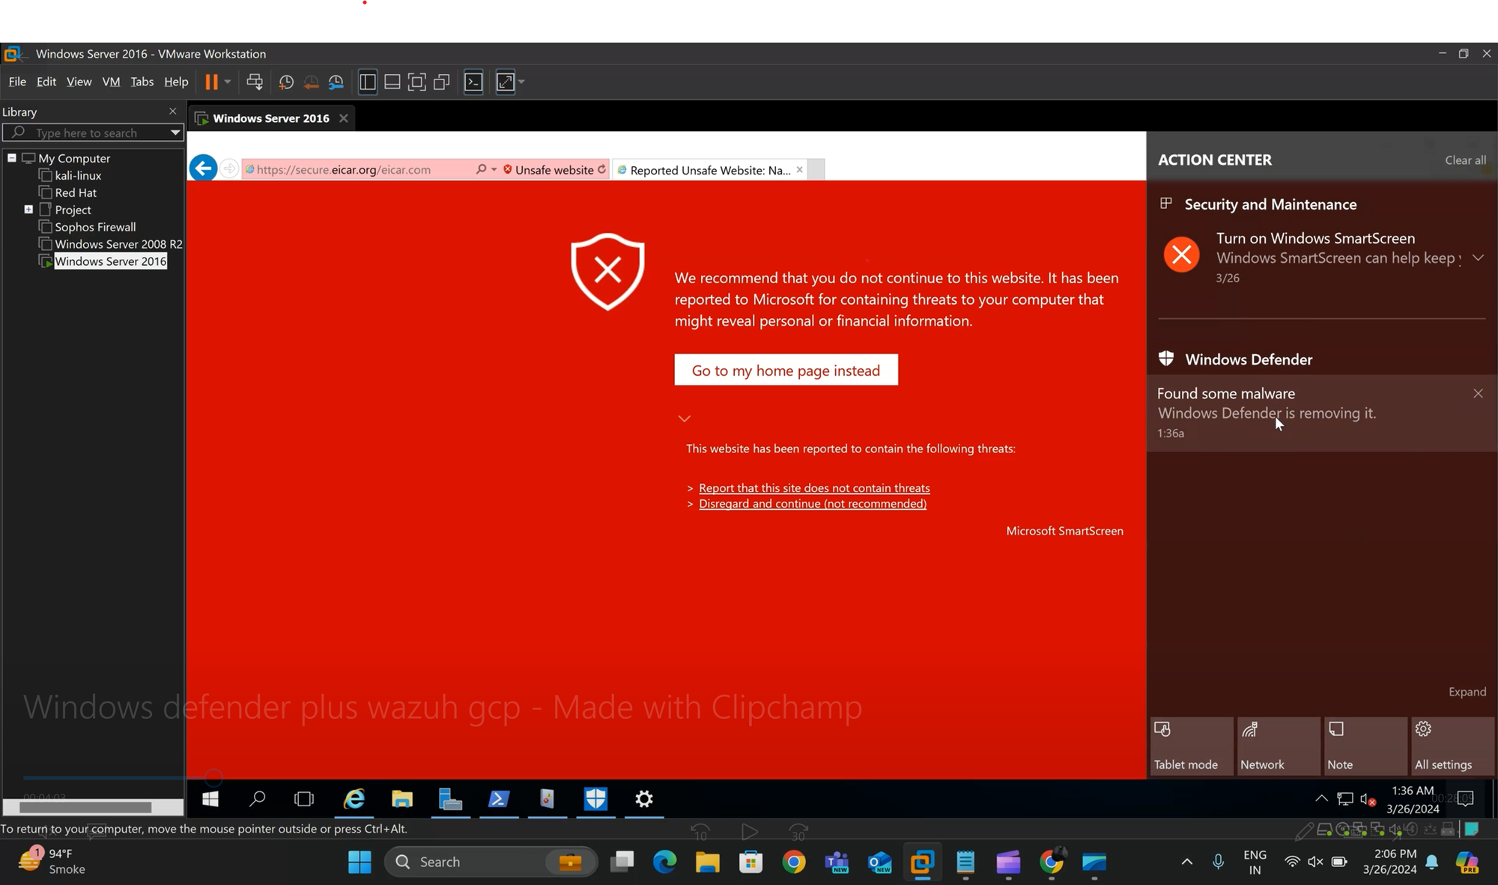
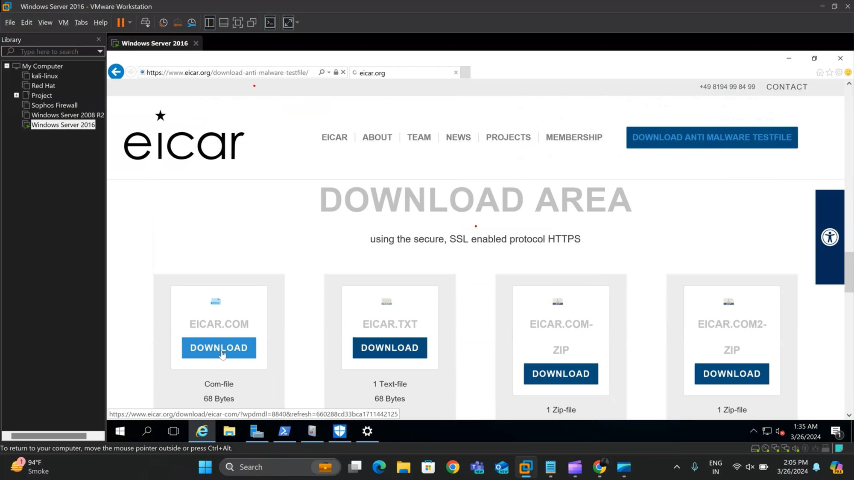
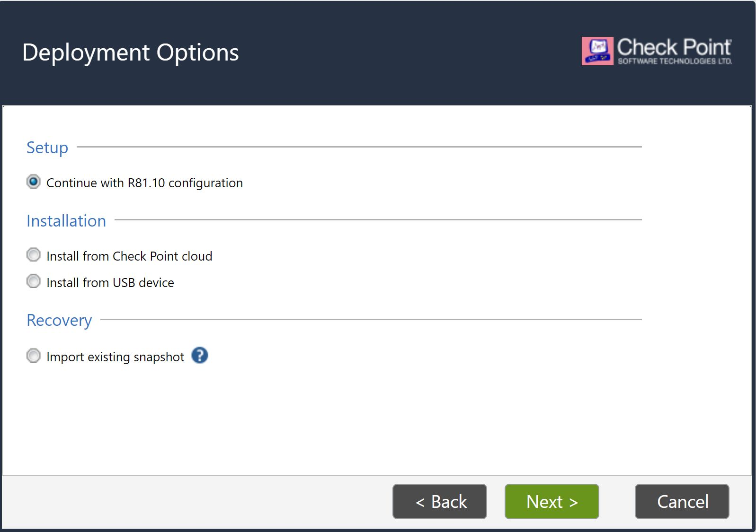
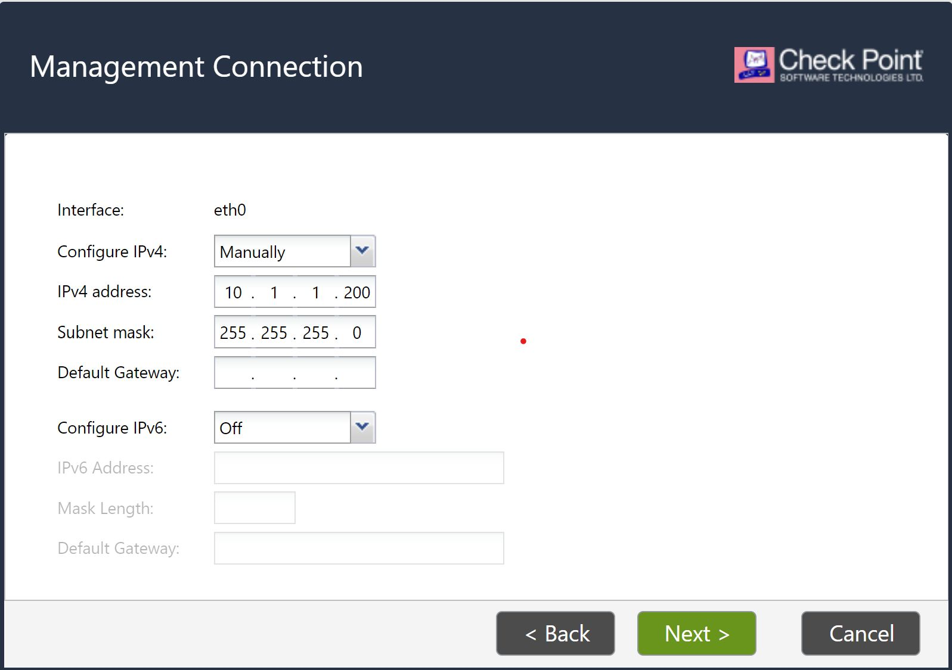
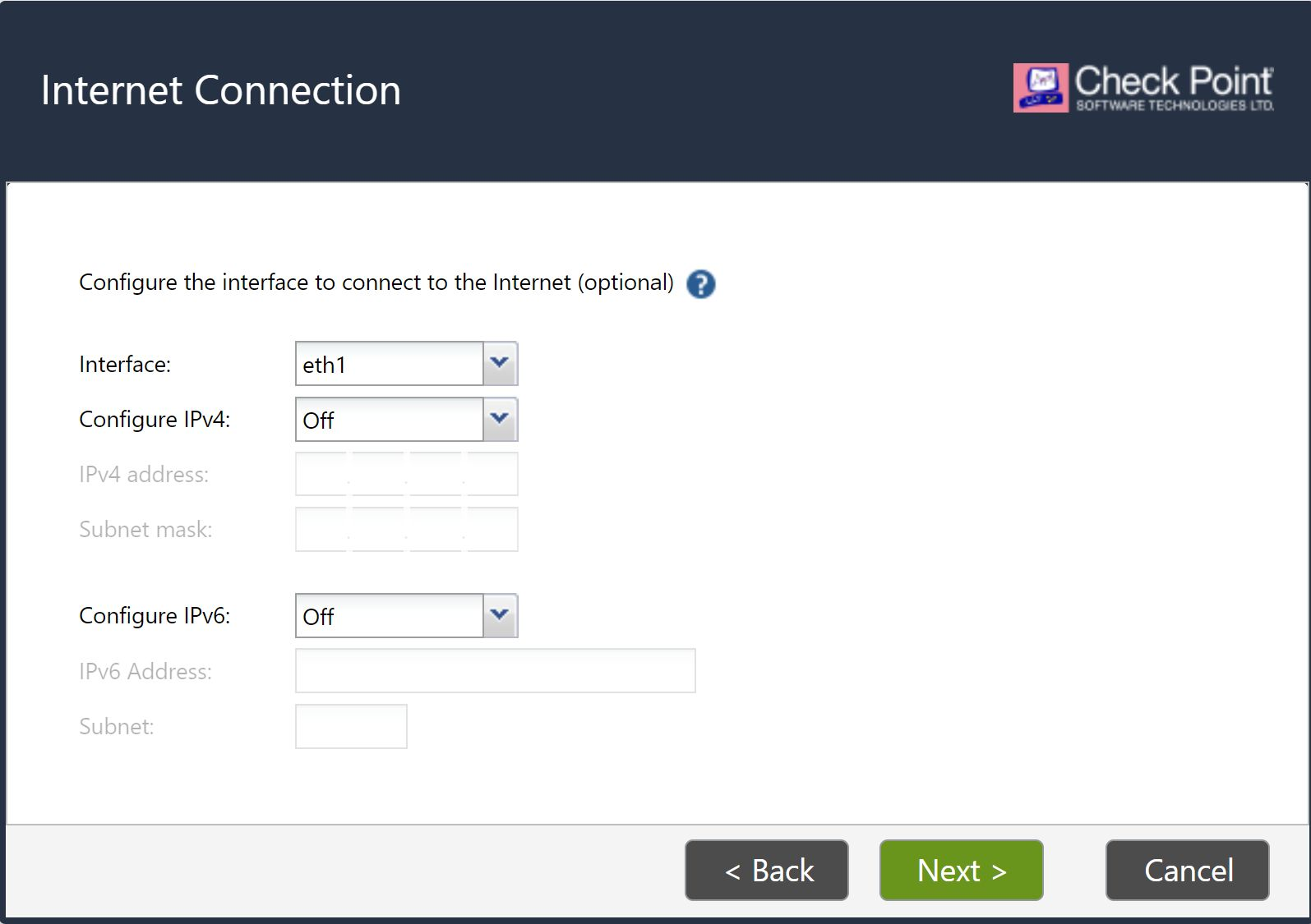
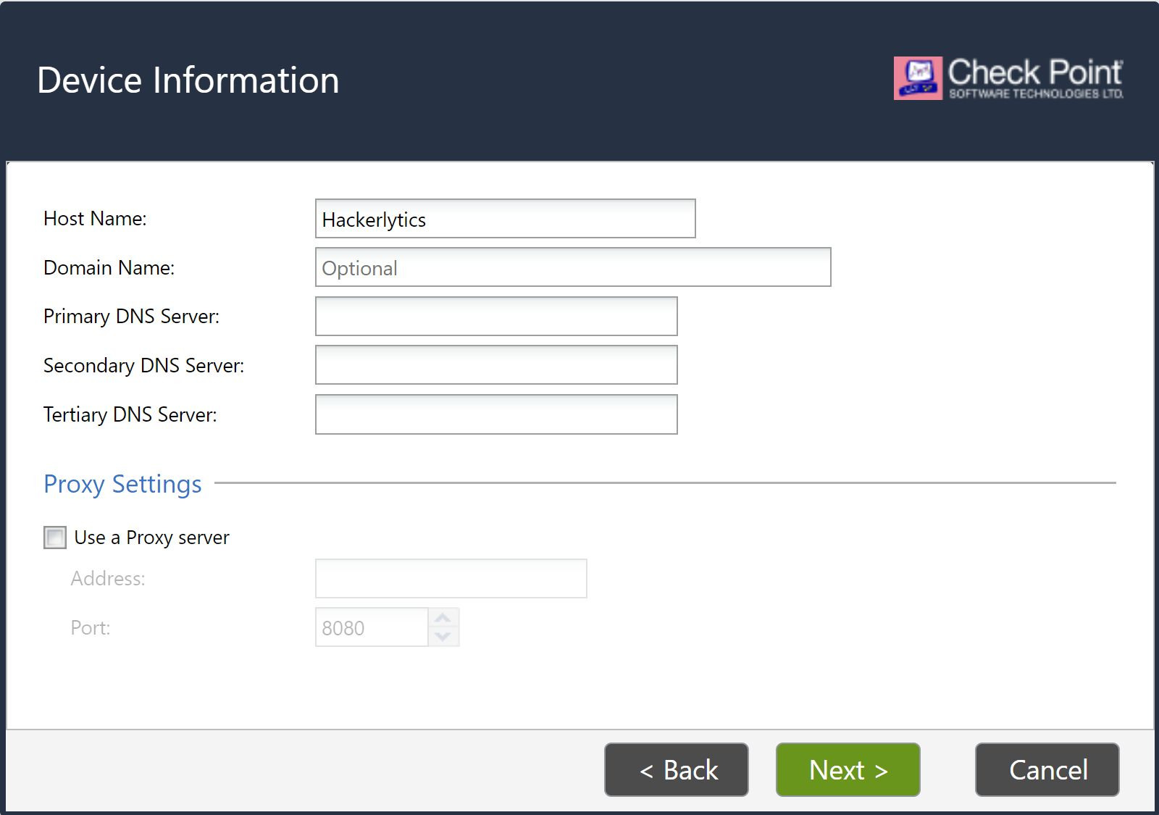
Holistic Threat Monitoring and Response
so now that this is running uh now if we try to grab a like a test file so like let's trigger this icar we can see that windows defender has detected and it is in fact actually removing it for us now you know you know where is that log actually output like yeah we got a little notification with a pop-up but wazoo wouldn't be able to read that
By Sunil Upadhyay

Slide 28
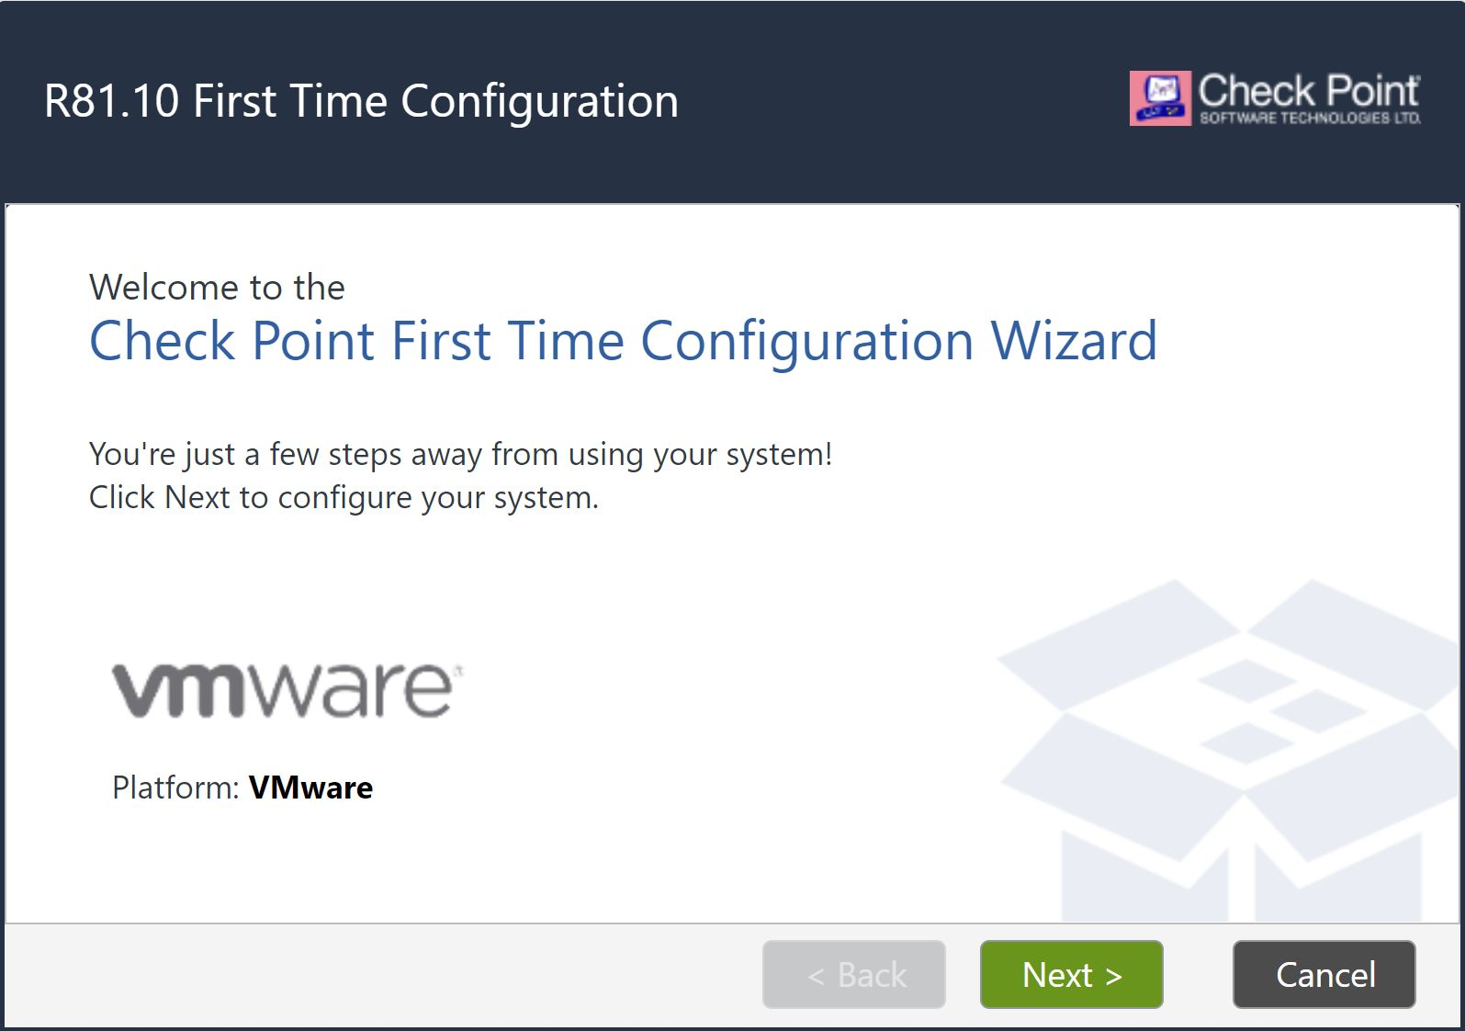
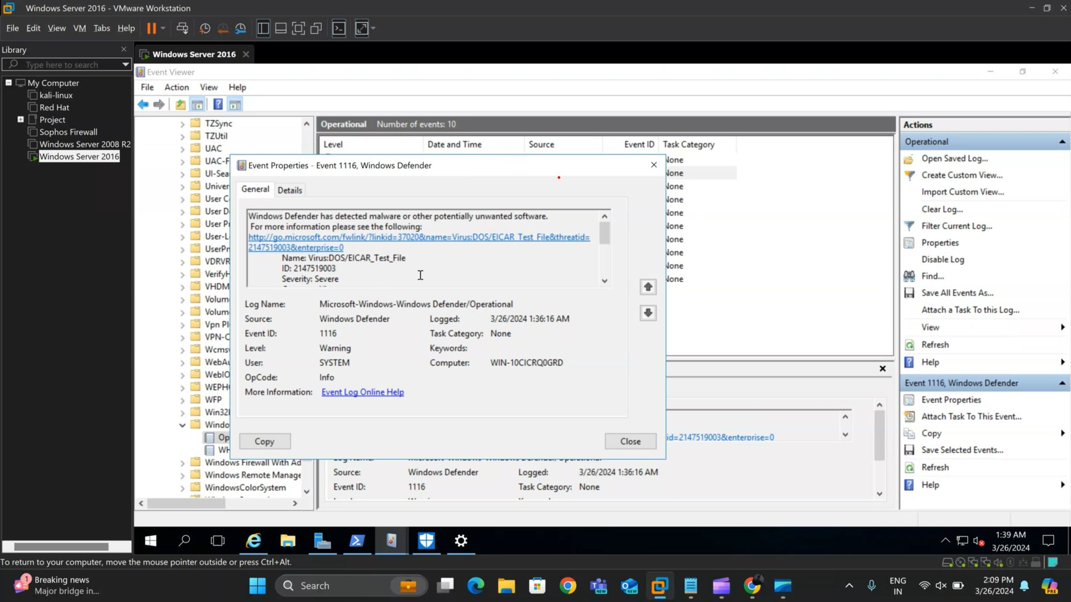
Holistic Threat Monitoring and Response
so by default if we open up our event viewer here we'll be able to drill down to all of our windows defender related logs so if we go into our application and service logs tree here we will then go into microsoft into windows and kind of similar to the sysmon and if we scroll down to our windows defender file here.
we'll see our operational block so if i go ahead and double click that you'll see that at at we got an alert for our icard test file that we see here and here we see when does the windows defender has detected malware or other potentially unwanted software.
By Sunil Upadhyay

Slide 29
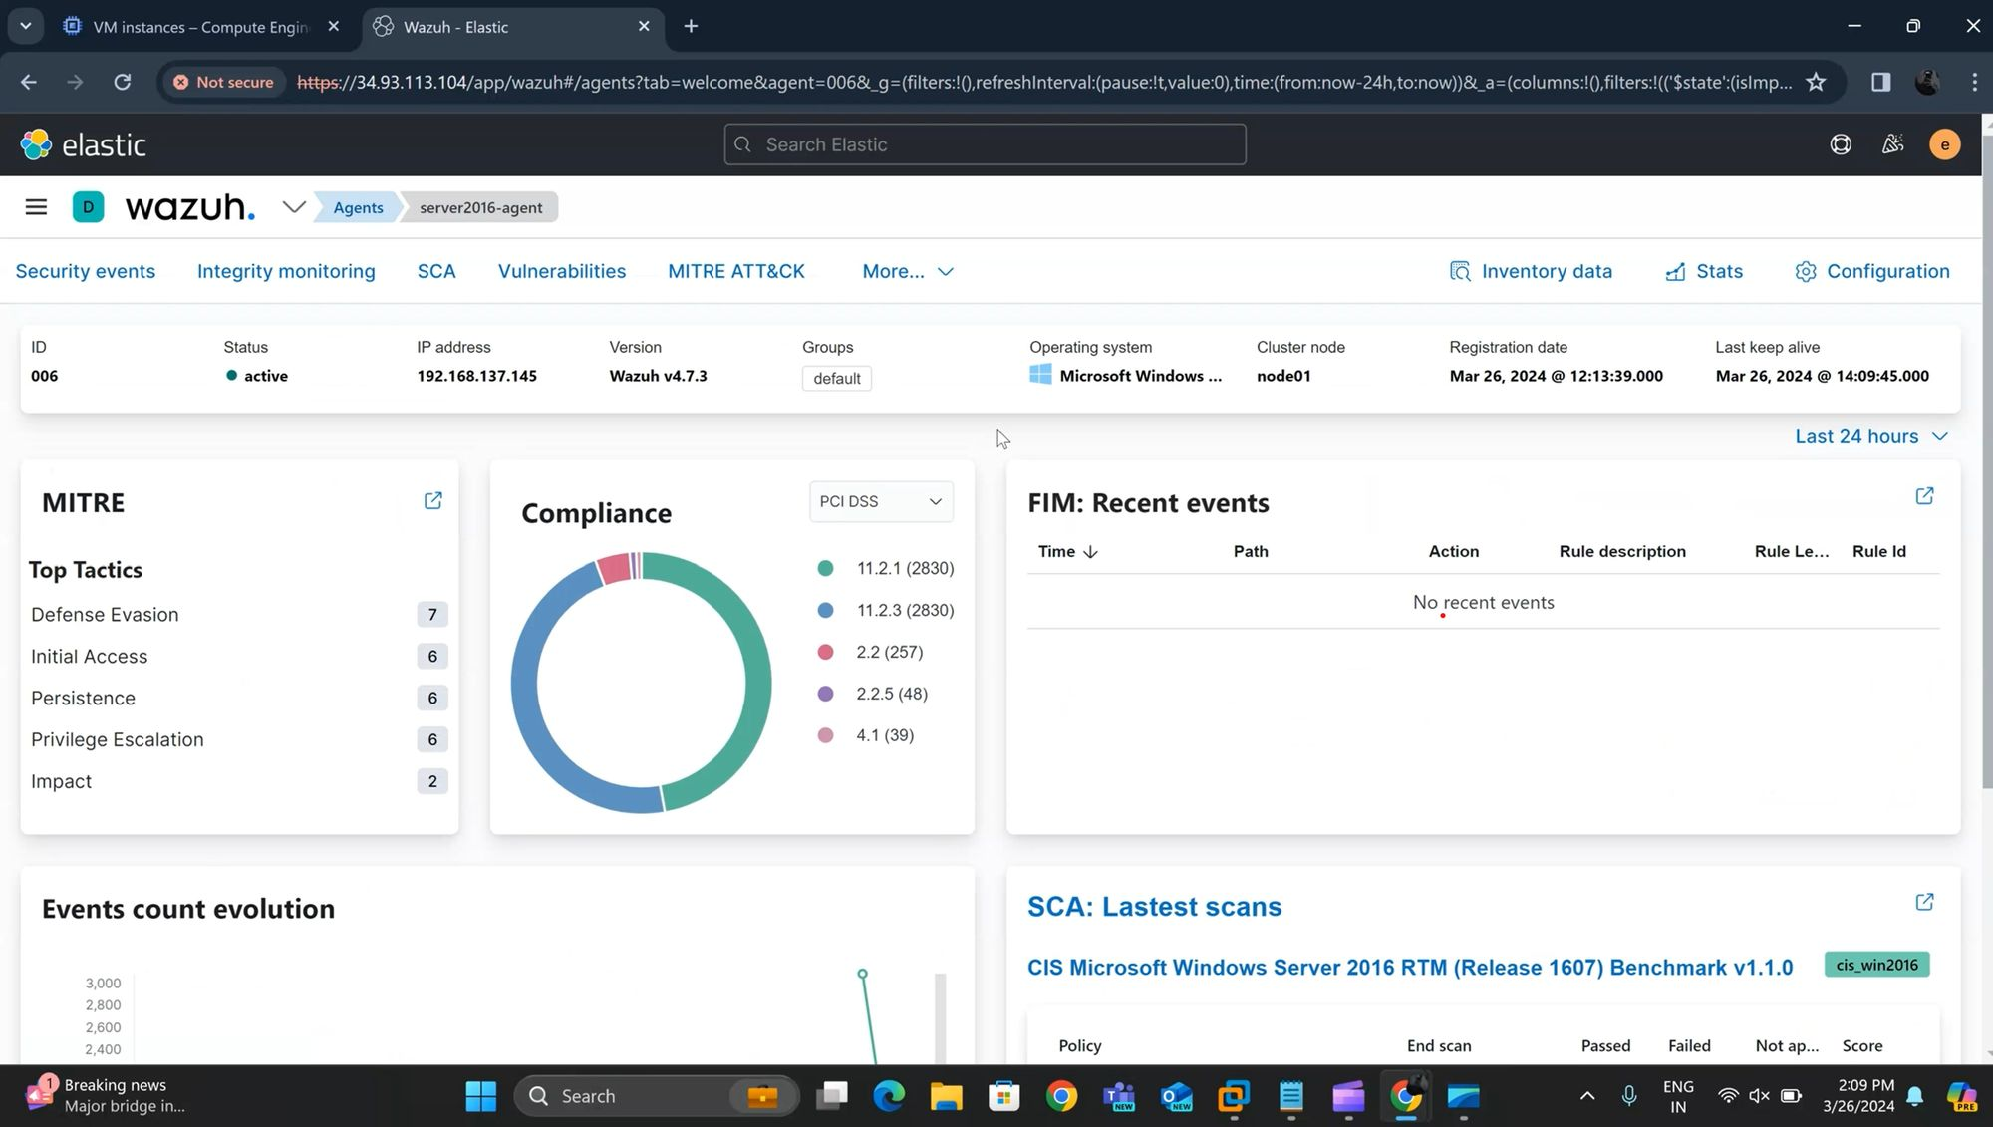
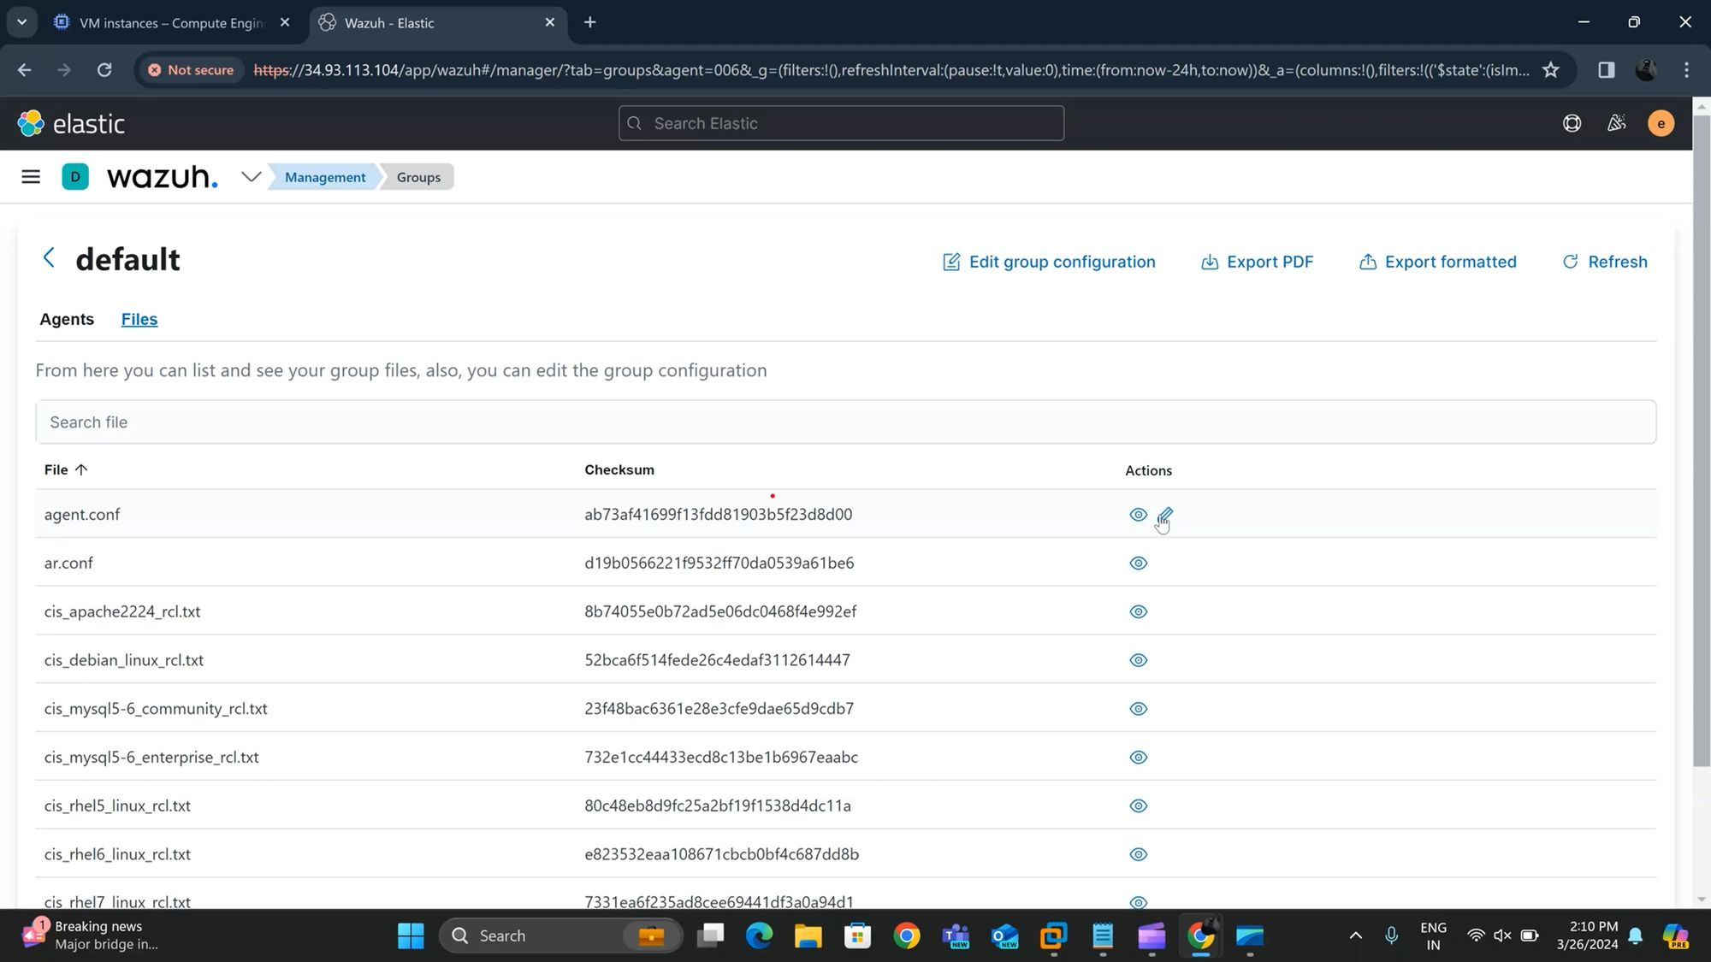
Holistic Threat Monitoring and Response
so if we go into our wazoo plugin here and i'll go under agents and here we see that this this windows agent which is the windows box that i am on is currently within the default group
so we can go ahead and select this group we'll select files and we'll select this agent.conf and we'll be able to edit this
By Sunil Upadhyay

Slide 30
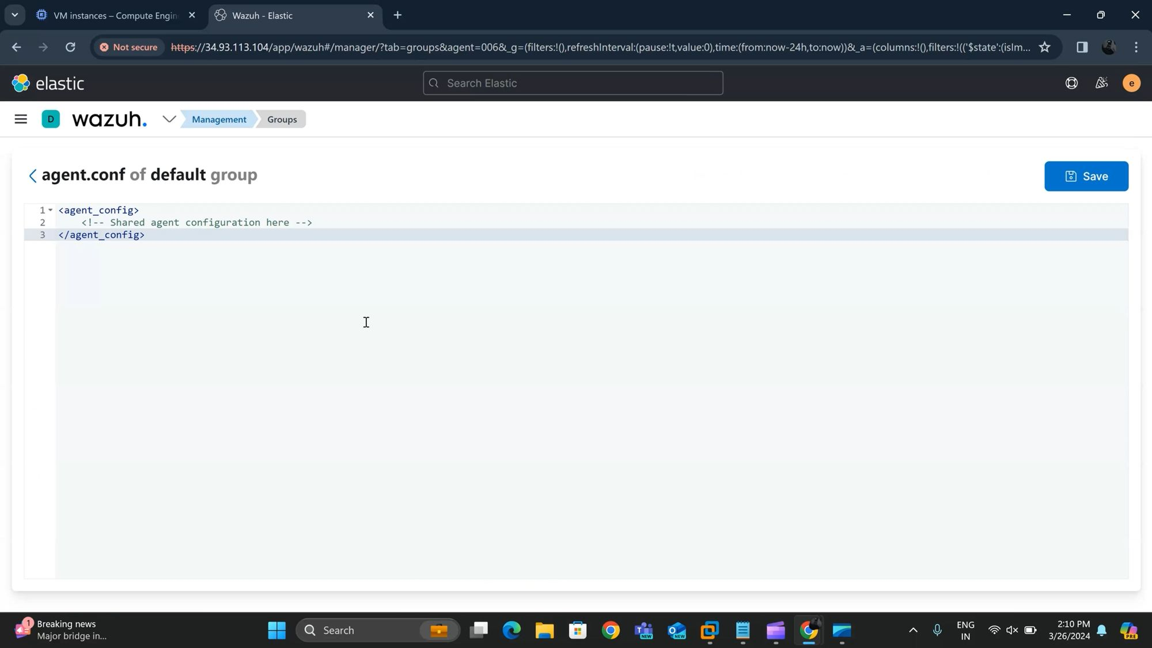
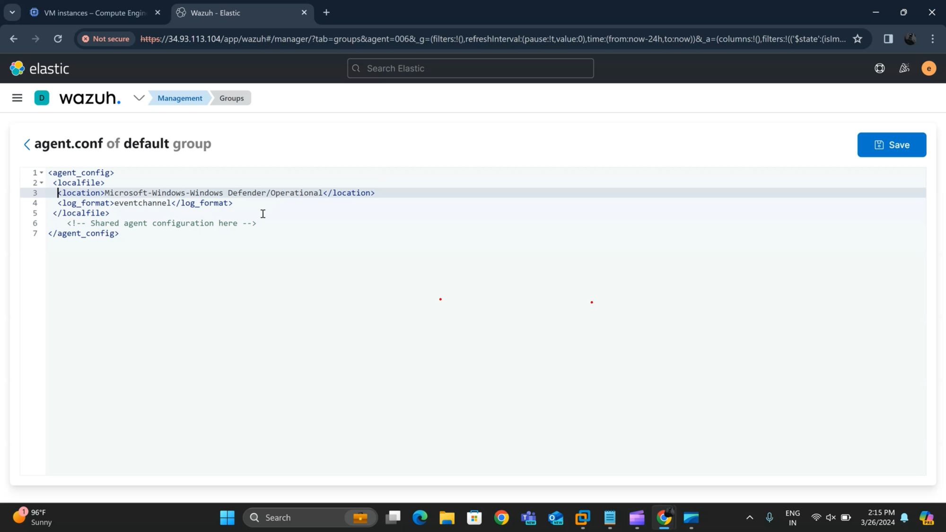
Holistic Threat Monitoring and Response
and once we edit and save this file this will push out to all of the wazoo agents that are within this default group so again what we need to tell our wazoo agent to do is say hey for every event that comes into this particular to this event viewer log which is this microsoft windows windows defender operational i want you to gather that up and send that to our manager so if we go back into here we can just simply add this block here
By Sunil Upadhyay

Slide 31
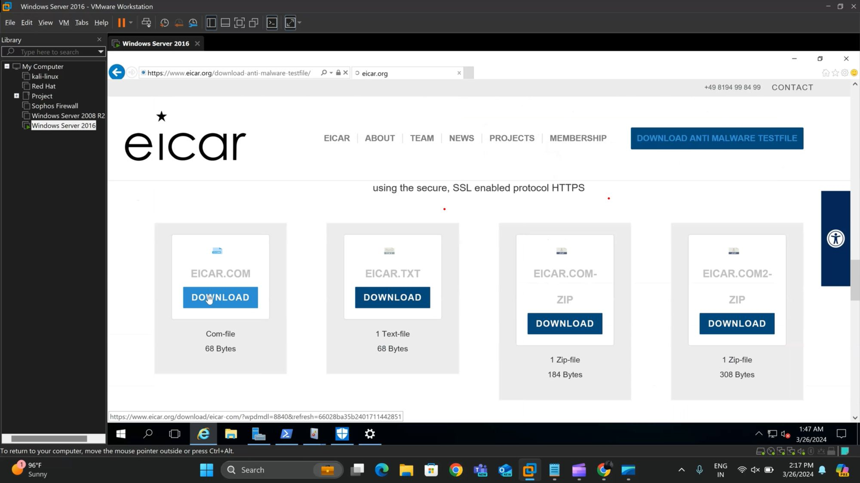
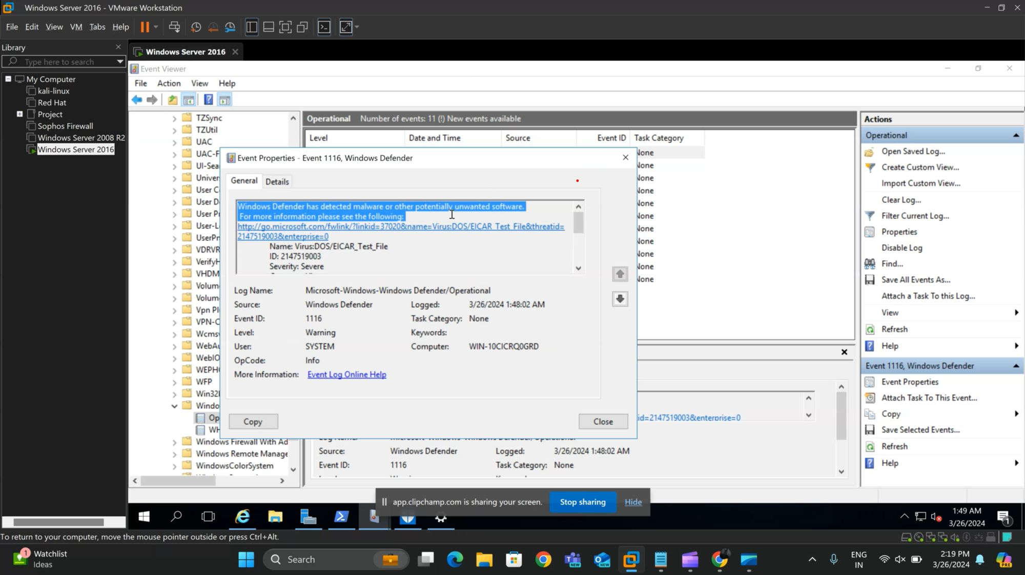
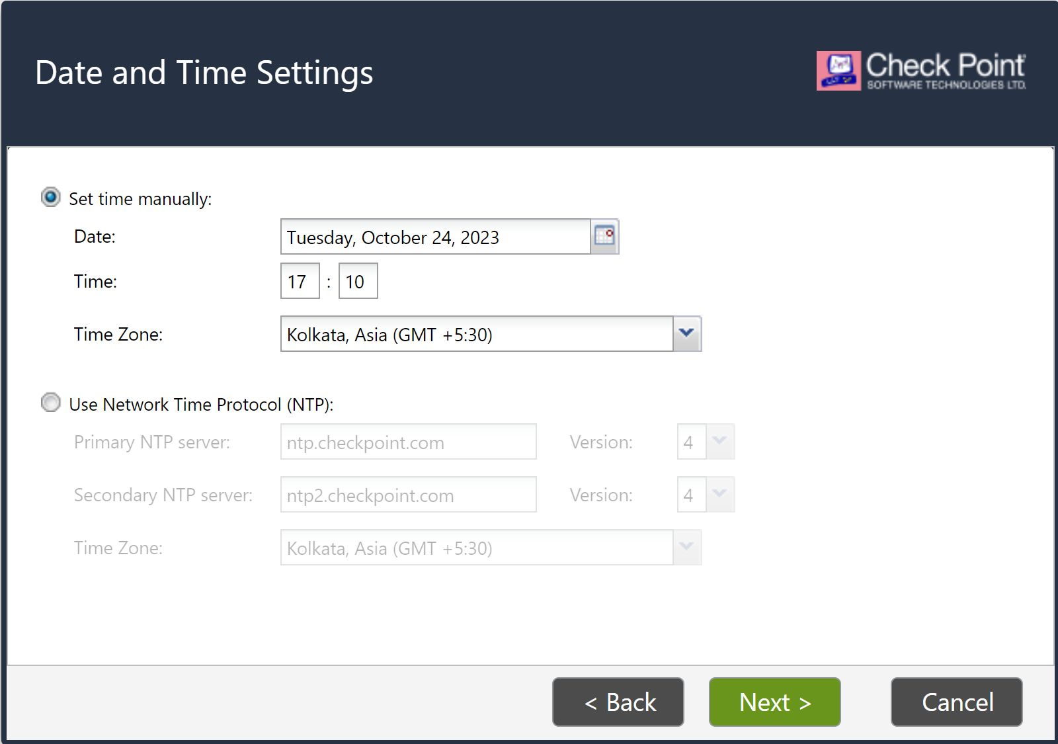
Holistic Threat Monitoring and Response
so now our wazoo agent is now going to gather up these logs and send them to our wazoo manager so if we go ahead and jump back on to this agent's particular dashboard.
let's now trigger the same alert so if we go ahead and we'll just grab this guy again so we'll see windows malware has detected it.
if we go into our event viewer here and refresh we see our new entry here so that looks good so it's detected our log file.
By Sunil Upadhyay

Slide 32
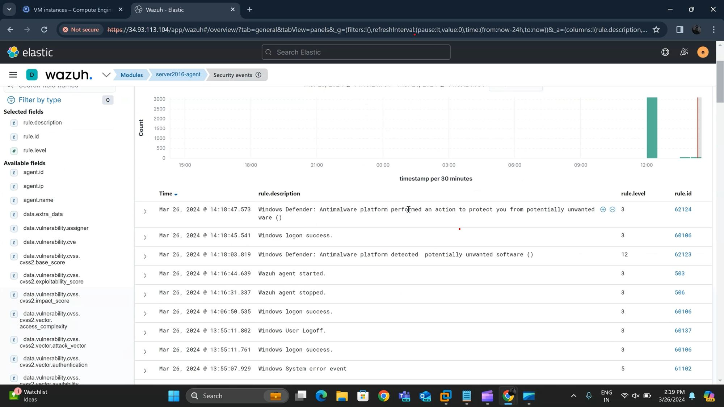
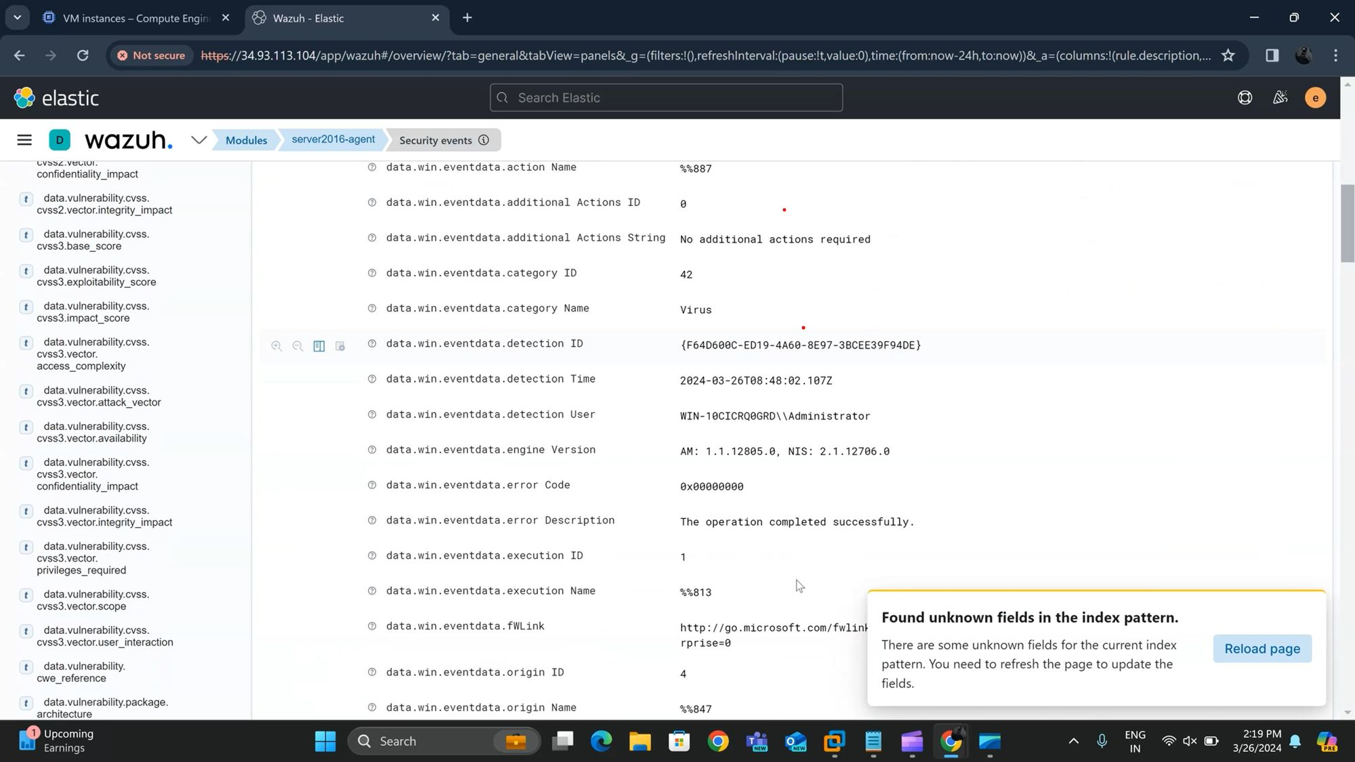
Holistic Threat Monitoring and Response
so we first get our output windows defender has detected a potentially unwanted software so meaning malware and then we can see it performed an action to protect us and that is windows defender actually quarantining the file for us.
and if we expand this out we get all the metadata around that particular file that windows defender recognized as being malicious so here you can see it this icarcom tried to file tried to be written into our downloads directory and we see all the metadata around it which is really nice.
By Sunil Upadhyay

Slide 33
Integrity Monitoring and Assurance
Integrity monitoring in security, particularly within Wazuh, involves the continuous monitoring of critical files, directories, and system configurations to detect any unauthorized changes or tampering.
It ensures the integrity and security of the system by alerting administrators to any deviations from the expected state.
This is crucial for maintaining a secure environment as it helps prevent unauthorized access, data breaches, and the exploitation of vulnerabilities.
By Sunil Upadhyay

Slide 34
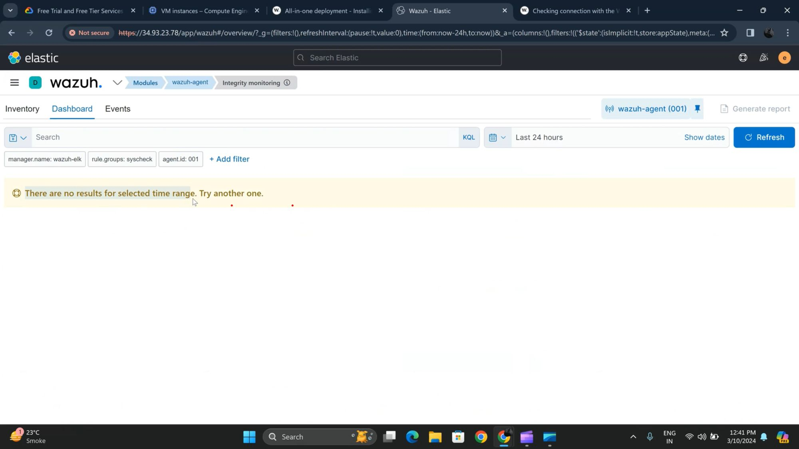
Open the wazuh manager dashboard and go to the Integrity Monitoring. It Is by default disabled you have to make it enabled
By Sunil Upadhyay

Slide 35
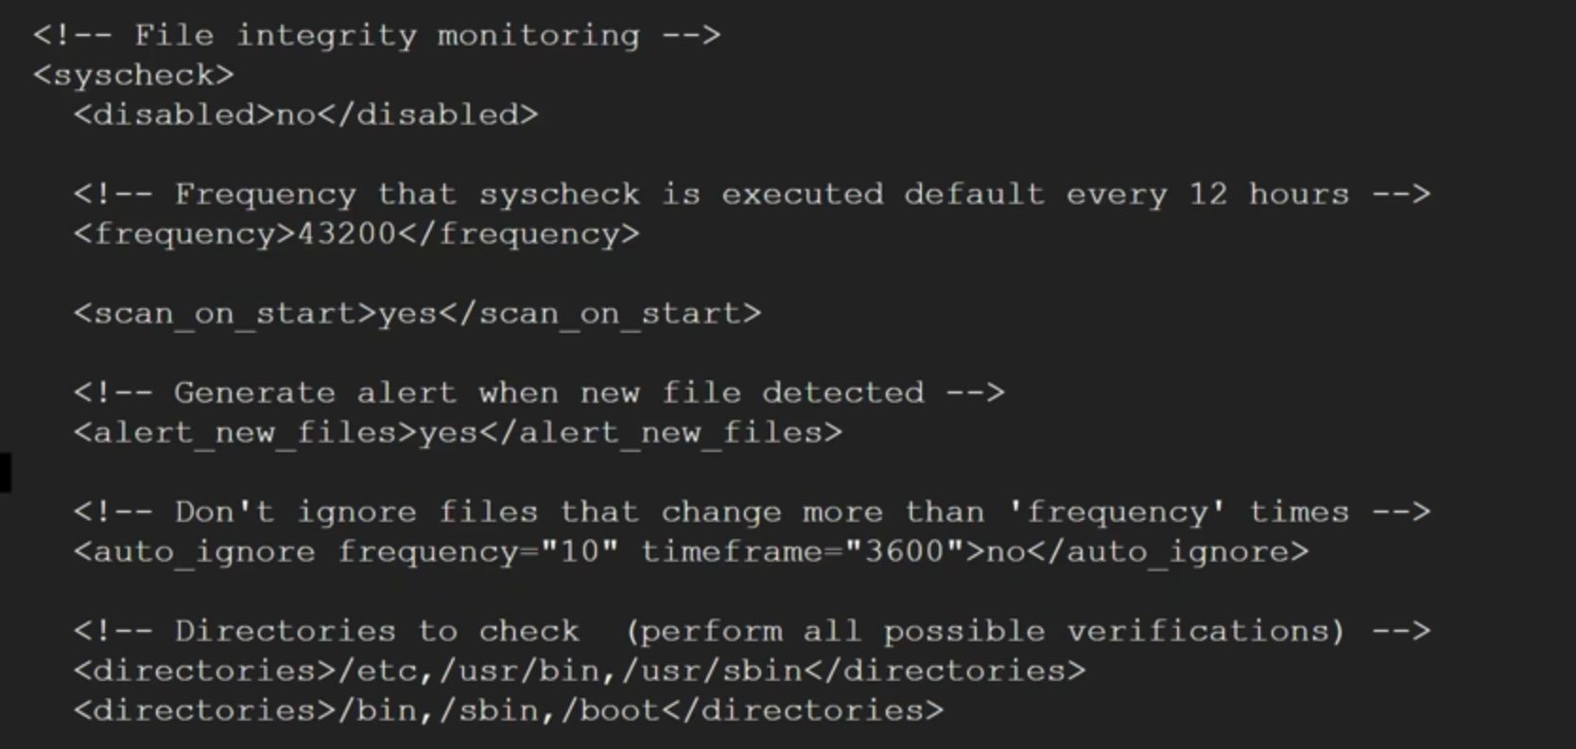
Let's configure some files to enable this file integrity tool just go into the command line of wazuh manager and open the /var/ossec/etc/ossec.conf file to configure and find the file integrity monitoring module and make sure it is enabled
By Sunil Upadhyay

Slide 36
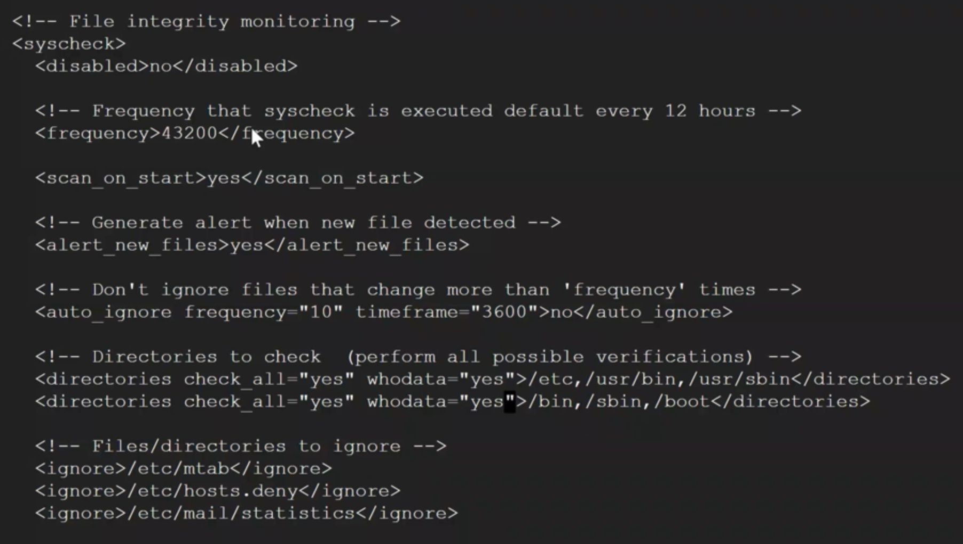
We need to edit directory's so wazuh manager can gather data in real time basis so we have to edit like this as shown in the below picture.
By Sunil Upadhyay

Slide 37
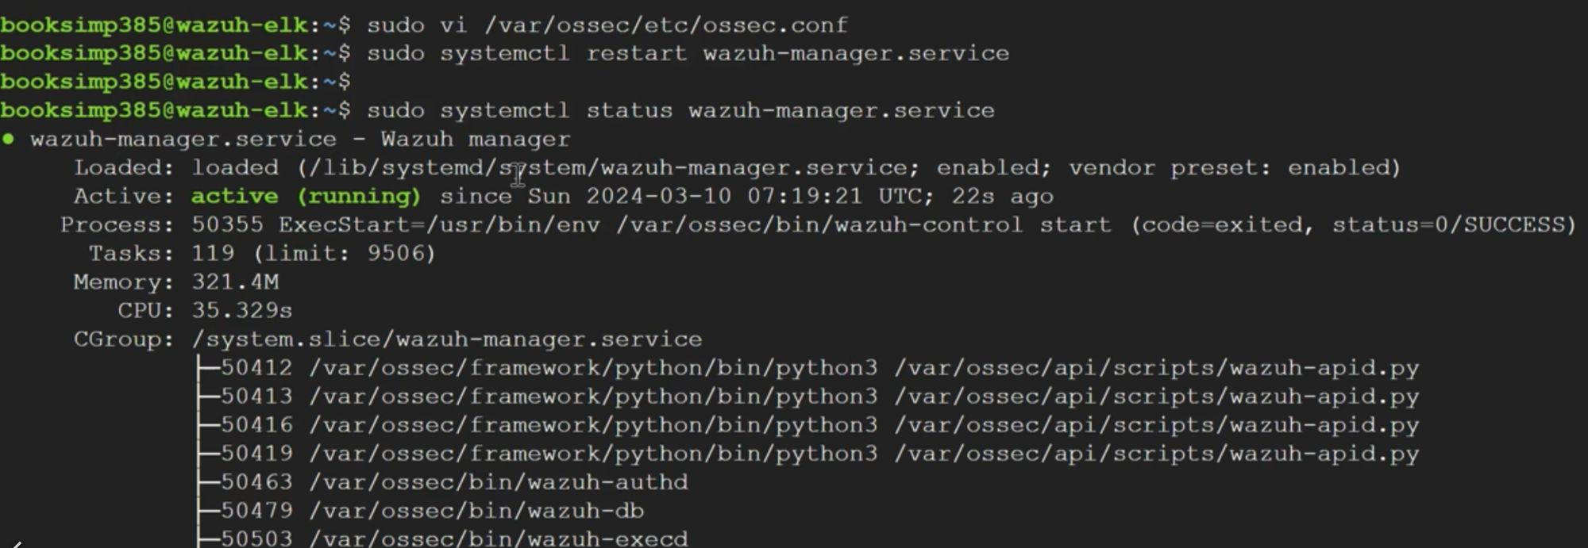
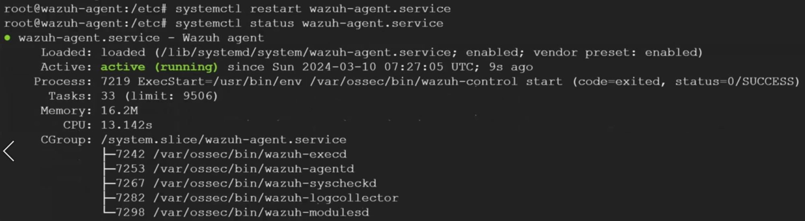
We did configuration in our wazuh manager's config file so firstly we have to do restart the wazuh manager service.
The same file is also available in the agent side you have to also configure this file as same as we did for the wazuh manager. Configure that file and also restart the wazuh agent service.
By Sunil Upadhyay

Slide 38
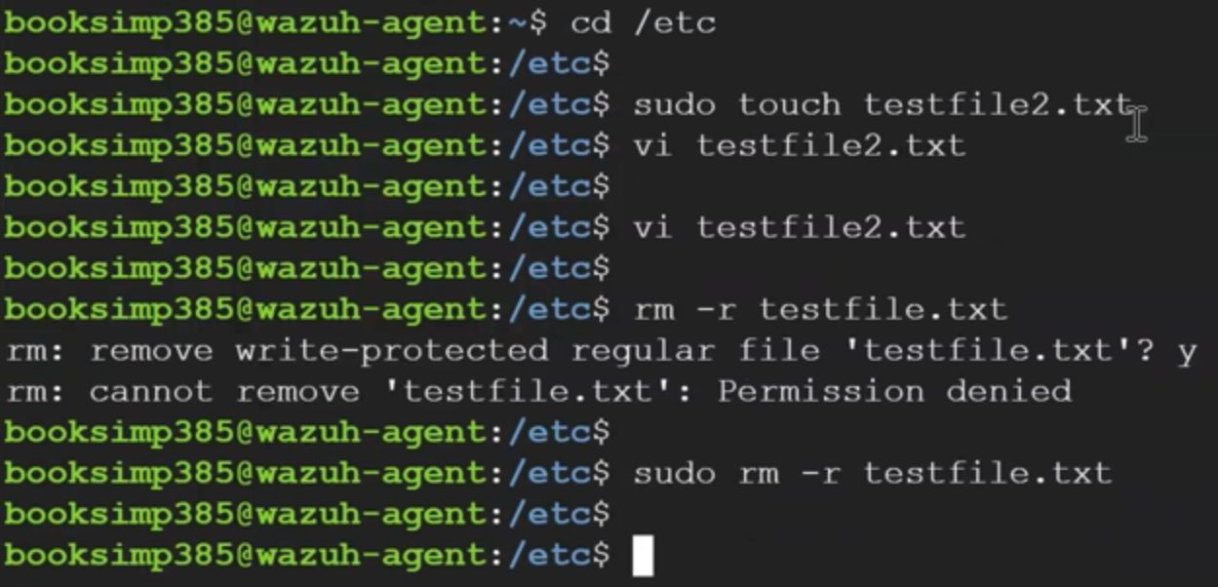
Let's do some work so that we can trigger some alerts or notifications in our wazuh manager. we are doing like creating some empty files then modifying it and also deleting so let's hope for the best.
By Sunil Upadhyay

Slide 39
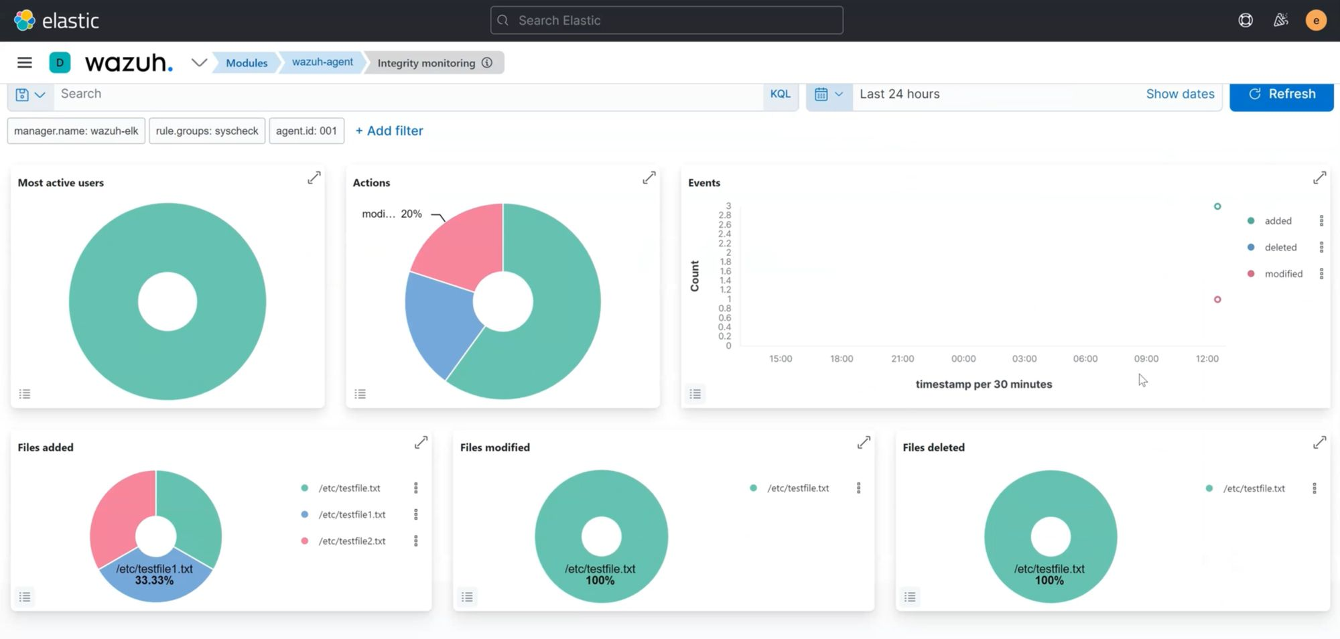
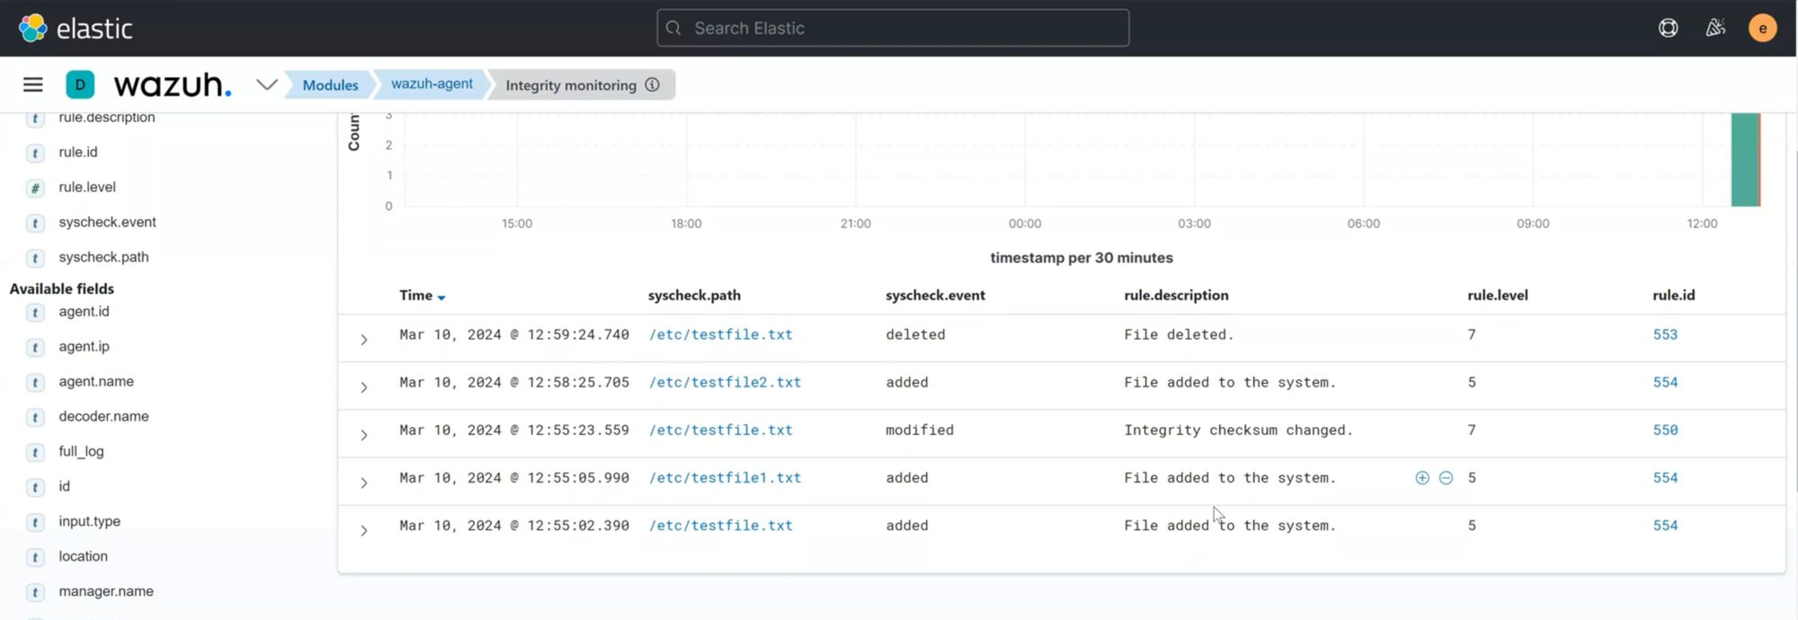
Let’s check it in the wazuh manager if it is triggered or not.
Soo we can see that there are also three options which we have did right now we added the file modified the file and deleted the file.
By Sunil Upadhyay

Slide 40
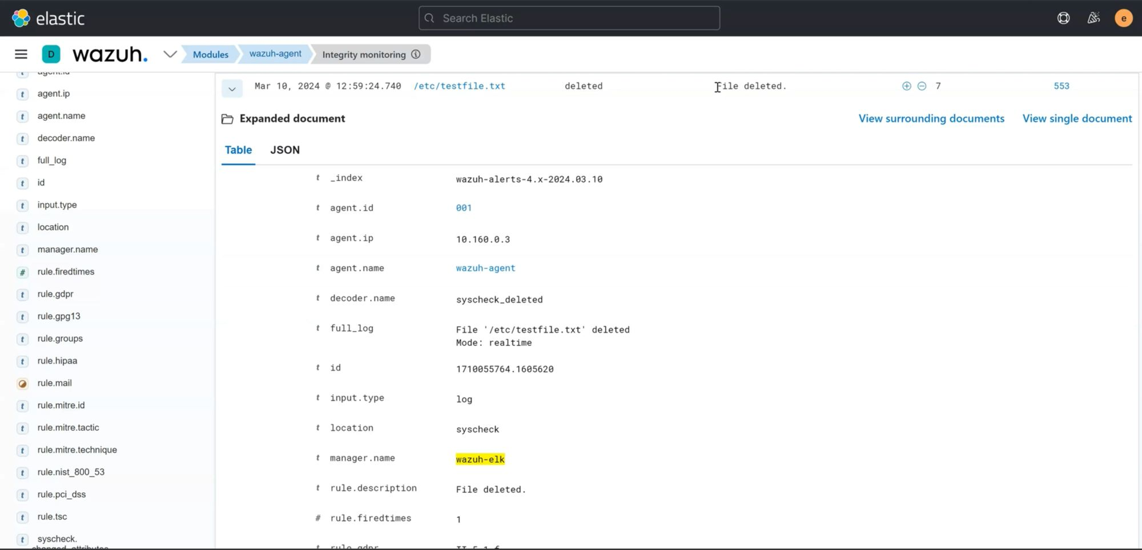
We can check here which file in the real time basis modified, deleted or added to the system.
By Sunil Upadhyay

Slide 41
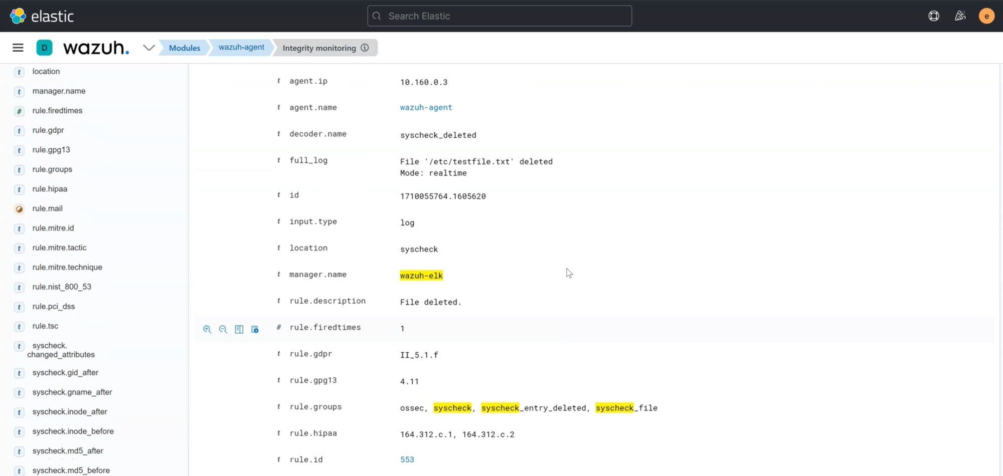
We can also explore that triggered event just click on that and scroll down then you can see full details and also logs like from where this file is created and all.
By following these professional steps to configure file integrity monitoring in Wazuh, organizations can effectively protect their data from theft and unauthorized access.
By Sunil Upadhyay

Slide 42
Comprehensive System Auditing
System auditing helps organizations identify and mitigate potential security risks and vulnerabilities.
By monitoring system activities and configurations, auditing can detect unauthorized access attempts, suspicious behavior, and deviations from established security policies.
Auditing logs can be analyzed to reconstruct the timeline of events, identify the root cause of the incident, and support incident response and remediation efforts.
By Sunil Upadhyay

Slide 43
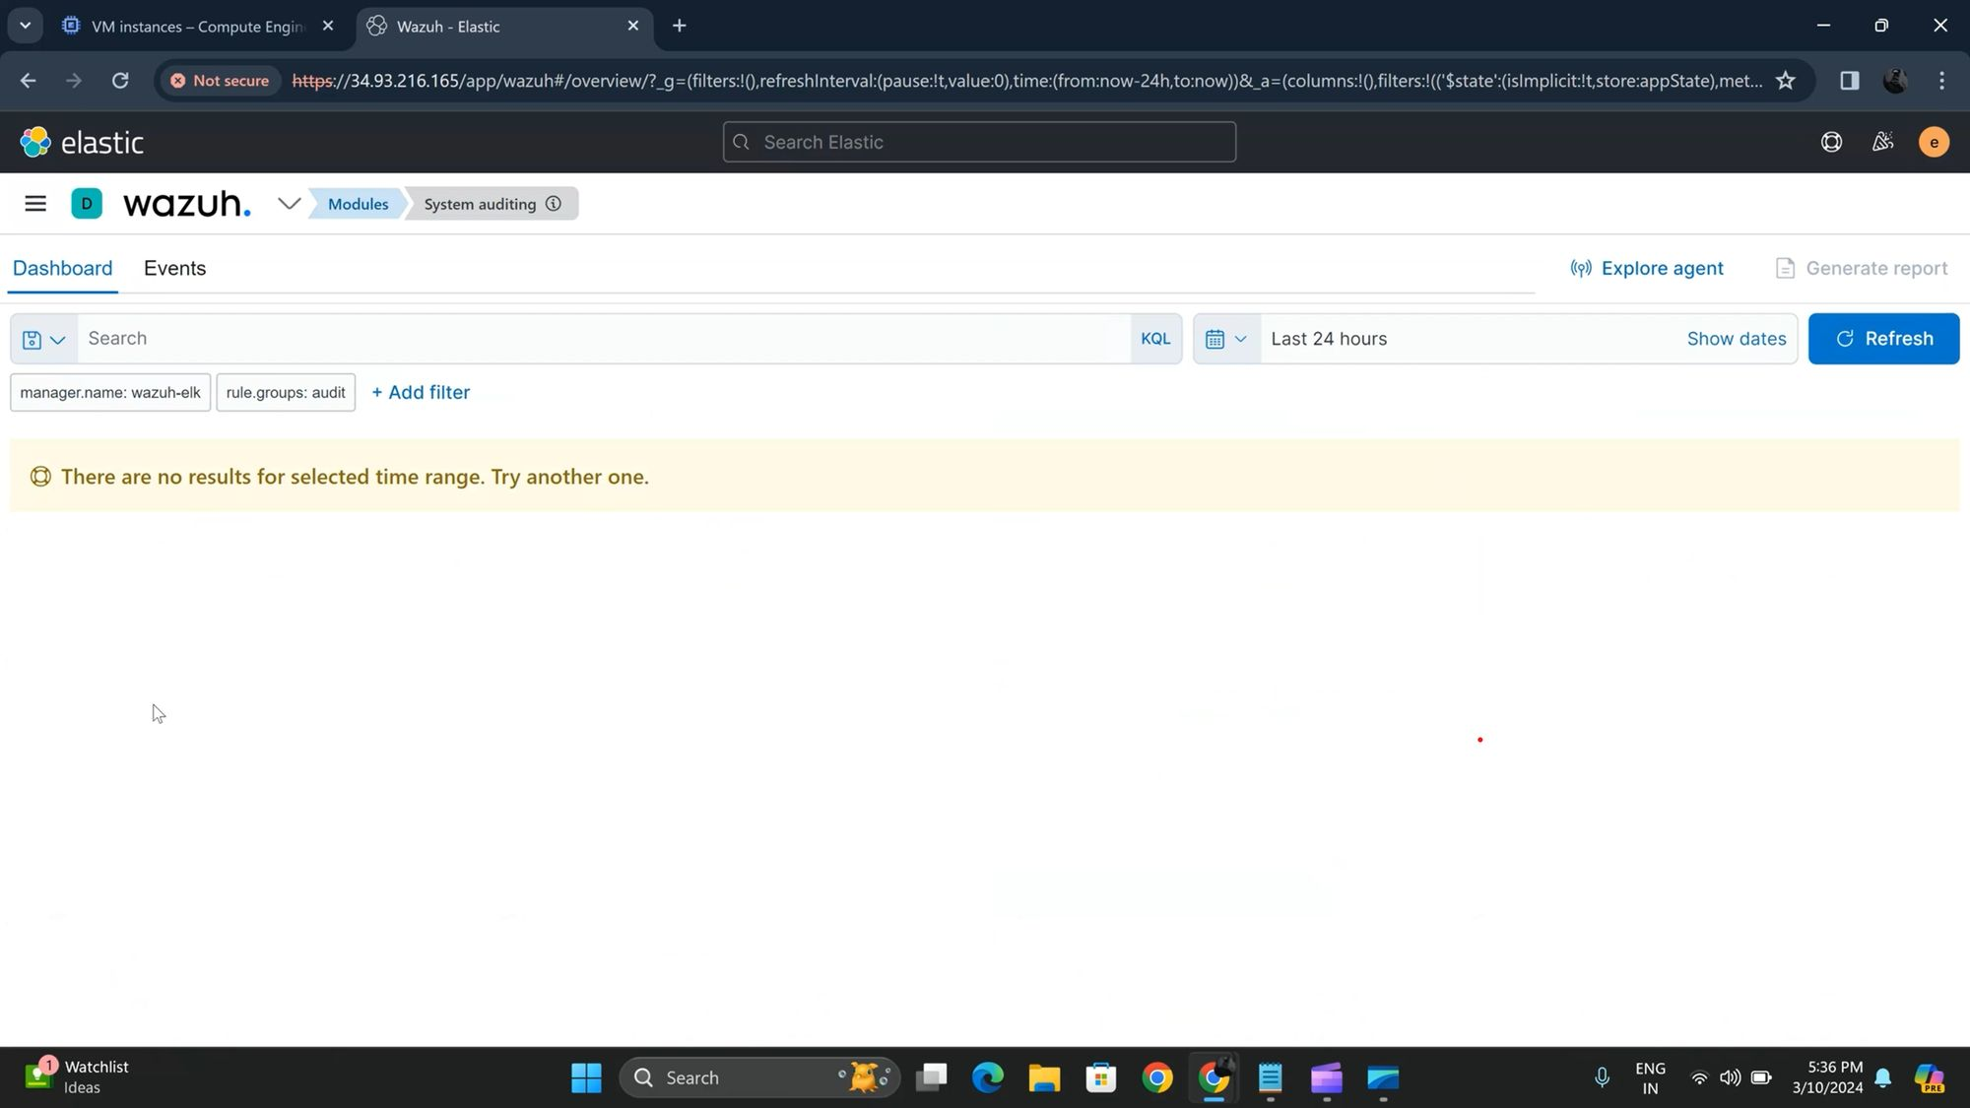
As we see in the pervious chapter the FIM Module is not enabled or not configured by default same as here the System auditing module also not enabled we have to configure it manually.
By Sunil Upadhyay

Slide 44
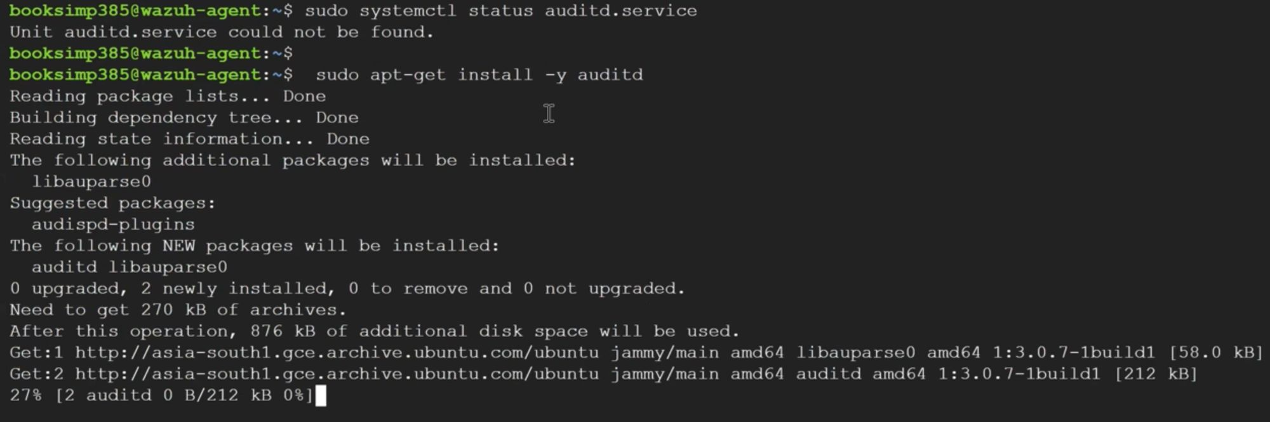
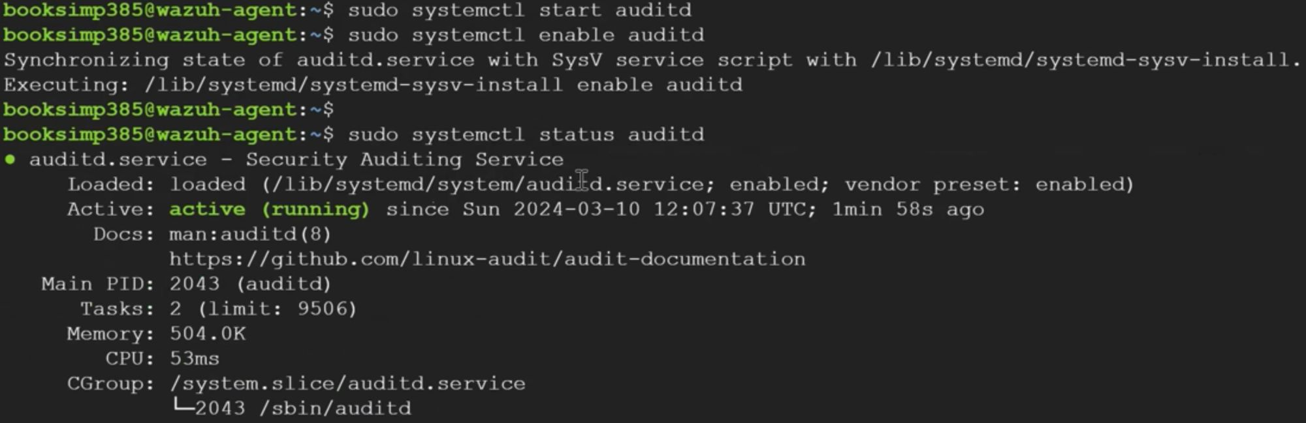
How we can configure it, Go to the wazuh agent, Firstly we have to install the auditd service on the agent side.
After installing successfully this service kindly enable and start this service and also don't forget to check the status of the service.
By Sunil Upadhyay

Slide 45
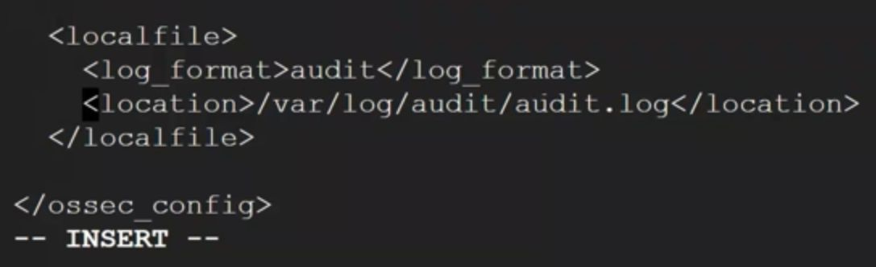
Now we have to configure ossec.conf file in the agent to manually enable the system auditing.
Open that file and scroll down to the end and add one log which is shown in the picture given below.
It should be added to the end of the file. save & exit. and also restart the agent service with
[sudo systemctl restart wazuh-agent]
By Sunil Upadhyay

Slide 46
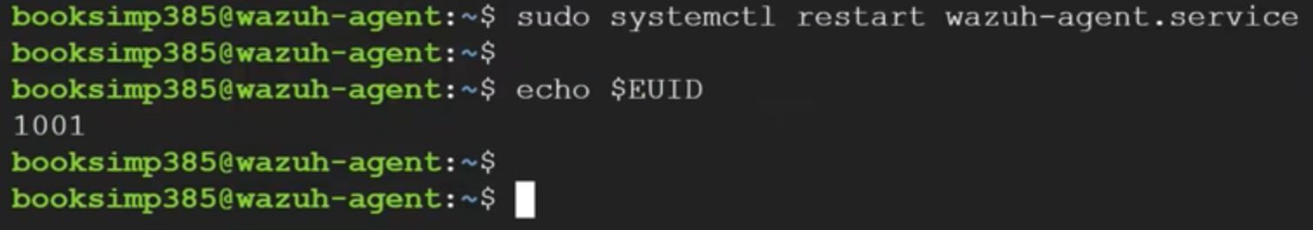
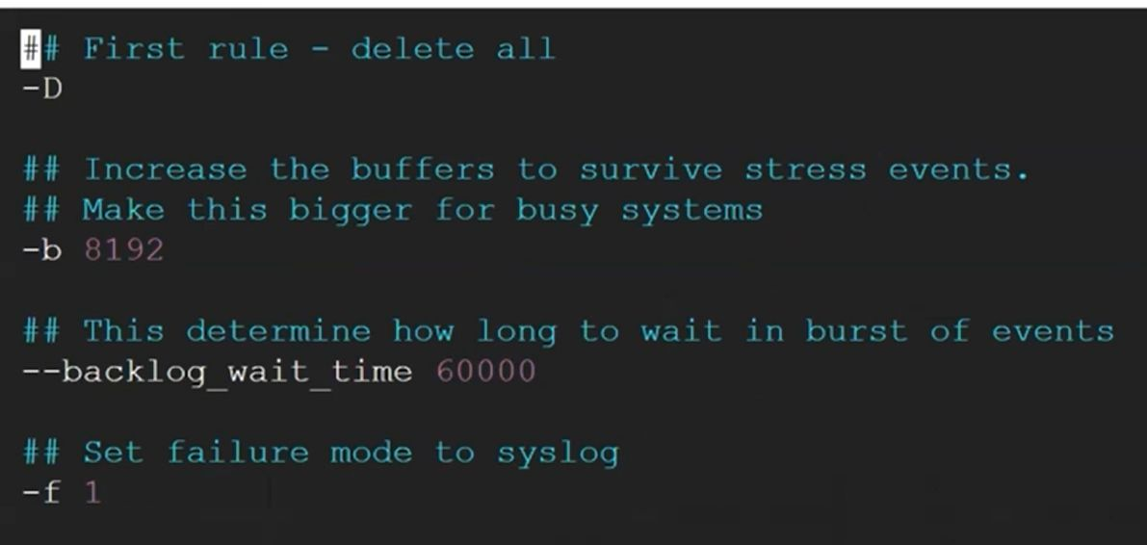
Our next step is to check the user i'd, For which user we have to do system audit for that we are gathering user's id.
So there is a rule file for auditd service and we have to configure it with adding some rules to gather real time auditing.
Open the file with
[sudo vi /etc/audit/rules.d/audit.rule]
You can see there is already pre-configured file like as shown below in the picture.
By Sunil Upadhyay

Slide 47
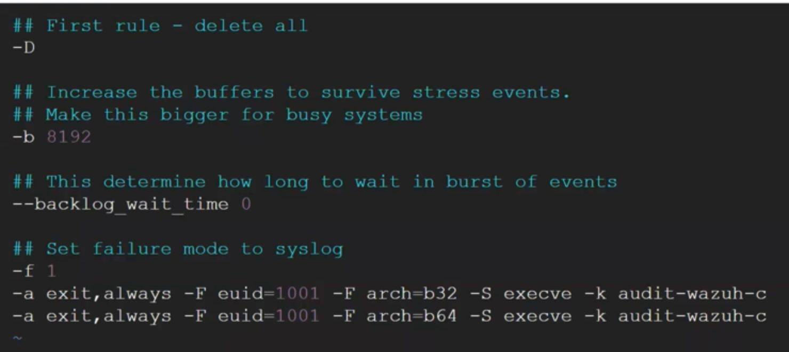
We have to edit this last two rules in that file kindly replace your user id with yours.
This commands wil help you to enable this rulewhich have define.
By Sunil Upadhyay

Slide 48
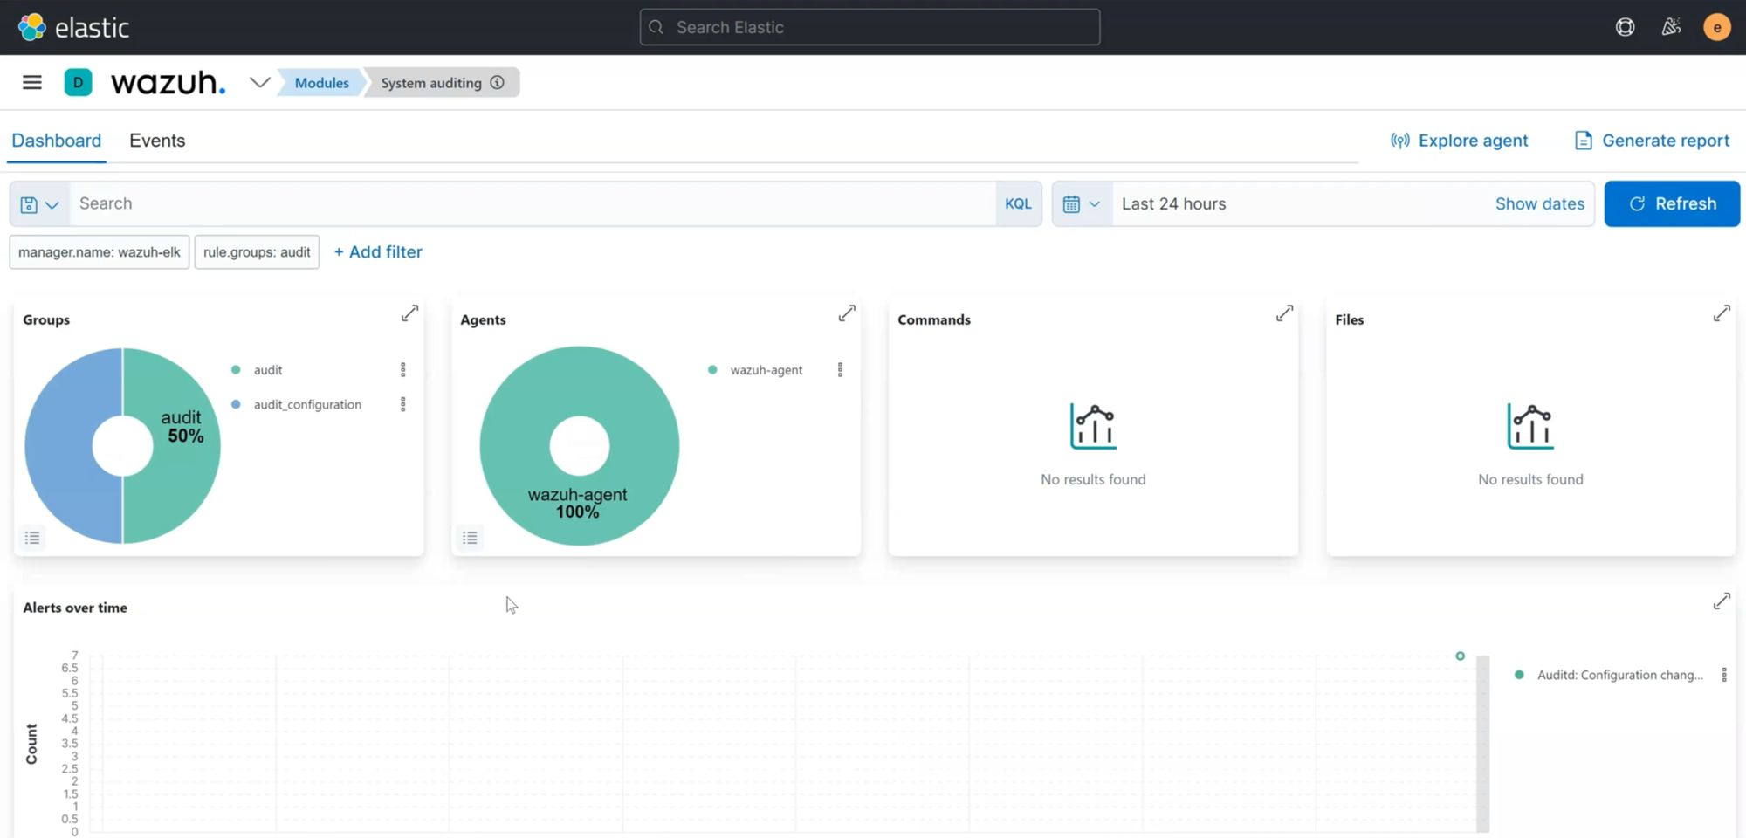
Now go back to the wazuh dashboard and open the system auditing module you can see as shown below picture.
You can see auditing service is enabled and lastly we modified the audit configuration file and also you can see there is only one agent which is 100% using.
You can also check the events section.
there is also events are triggered which we have did with the configuration file.
By Sunil Upadhyay

Slide 49
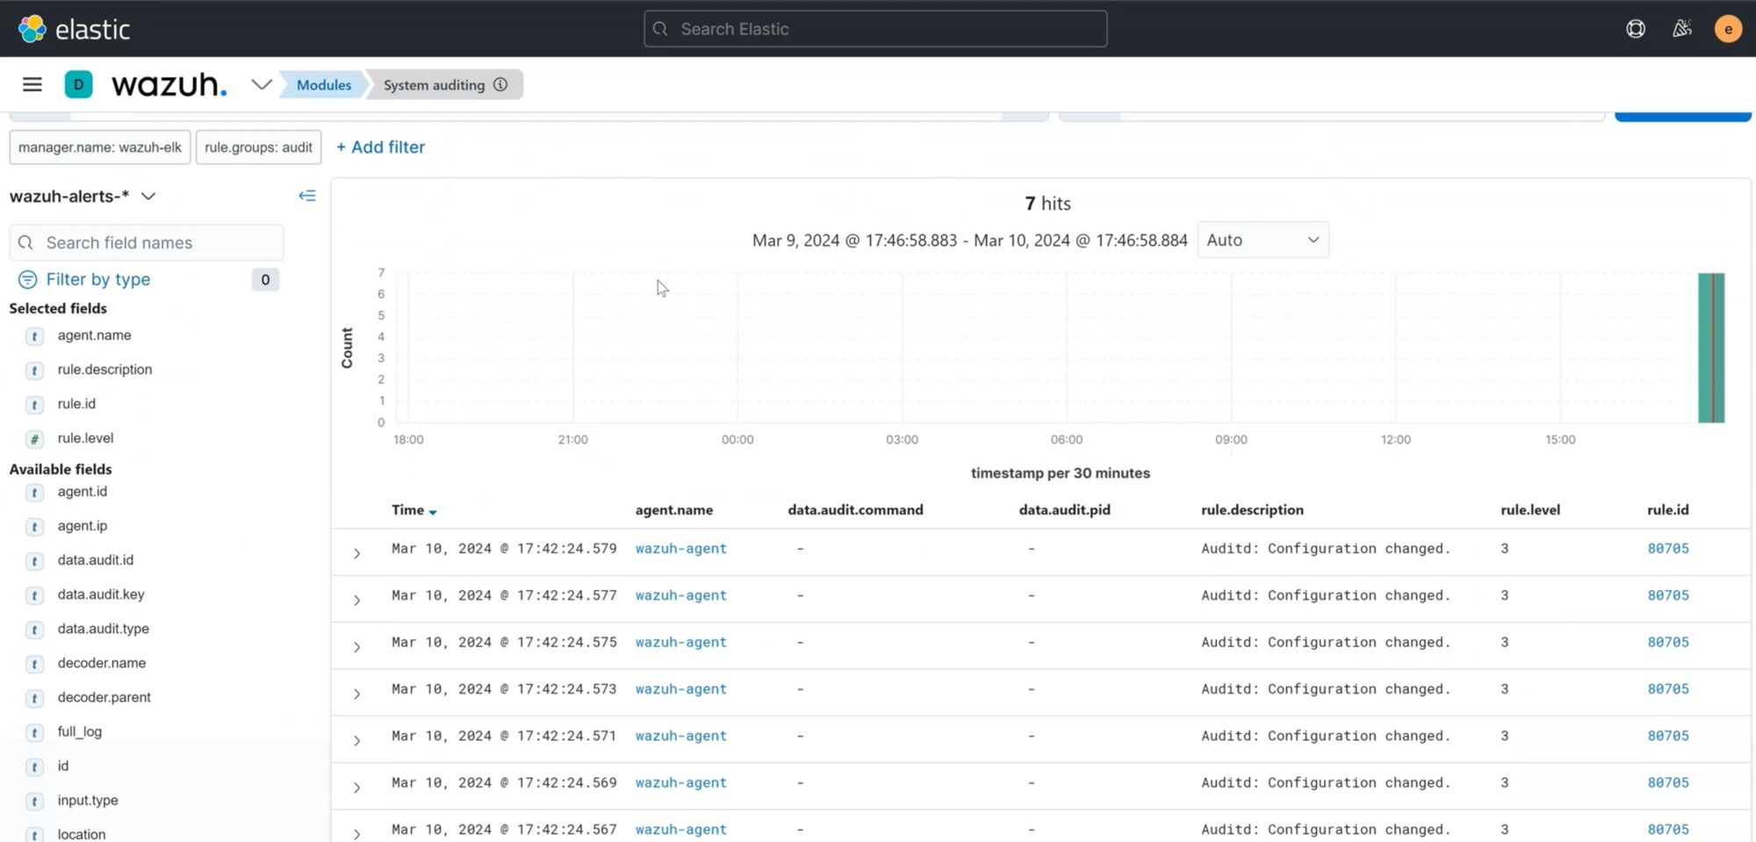
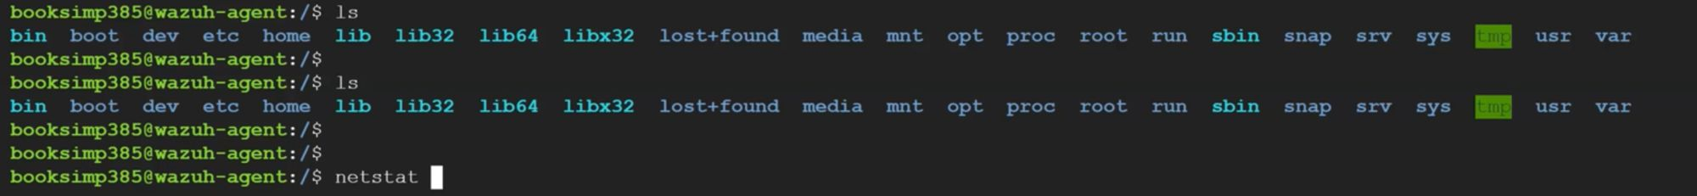
Let’s run some basic commands and check if we can trigger some events.
Let’s run some basic commands and check if we can trigger some events.
And here you can see the events are triggered of the commands which we have run on the wazuh agent.
By Sunil Upadhyay

Slide 50
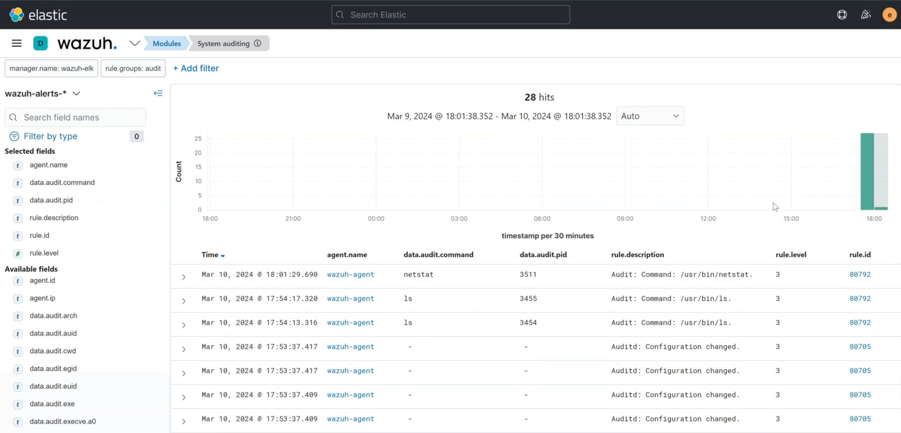
First three events is which we have triggered two time LS command and one time NETSTAT.
You can also exapand this event and check like which type of information showing so also we can check here which agent is running this command which user is running this command from where this command gets trigger and many more.
By Sunil Upadhyay

Slide 51


In summary, system auditing is indispensable for ensuring compliance with regulations, managing security risks, detecting and responding to security incidents, supporting forensic investigations, enhancing accountability, and demonstrating legal and regulatory compliance.
It is a fundamental component of effective cybersecurity and governance practices within organizations.
By Sunil Upadhyay

Slide 52
01
Enhanced Email Security
02
By integrating Wazuh with Outlook, organizations can enhance their email security posture by monitoring incoming and outgoing emails in real-time.
Wazuh can analyze email headers, attachments, and content for signs of malicious activity, such as phishing attempts, malware, or suspicious links.
Wazuh can analyze email attachments for known malware signatures or behavior patterns indicative of malicious intent.
It can detect and quarantine malicious attachments before they reach end-users, preventing malware infections and data breaches.
03
04
05
06
07
By Sunil Upadhyay

Slide 53

By we're going to look at configuring our wazuh manager to send us email alerts when rules fire over a particular level threshold.
So what this will allow us to do is to be able to have a email inbox that will alert us when a particular rule severity fires.
we can use to set up a smtp service and specifically tell our wazoo manager you know what smtp server we want to take advantage of this could be you know an internal smtp server that you have set up within your network or you could take advantage of a cloud-based smtp server.
so let's go ahead and look into doing that so i first have i'm taking advantage of this send in blue they're just a cloud smtp um solution so i guess free plug for these guys
02
03
04
05
06
07
By Sunil Upadhyay

Slide 54


so we're going to go ahead and take advantage of post fix to configure these credentials.
Grab the postfix software and download that and once that's done we'll move on to the rest of the config all right
03
Append these lines to /etc/postfix/main.cf to configure Postfix.
Create the file if missing.relay
Host will be our send in blue smtp server
04
05
Set the sender email address and password.
Replace <USERNAME> and <PASSWORD> with your own data.
06
07
By Sunil Upadhyay

Slide 55

Let’s change the permissions of files.
Let’s add some security & Secure your password DB file
i will go ahead and restart postfix so let's see if that service is up and running let's go ahead and start this guy okay.
04
05
06
07
By Sunil Upadhyay

Slide 56

Run the following command to test the configuration. Replace you@example.com with your email address. Check, then, that you receive this test email
As you can see we received the test email.
05
06
07
By Sunil Upadhyay

Slide 57


Open the ossec config file and find the gloable configuration and edit as shown in picture below. (replace emails and smtp server with yours).
Let’s go ahead and restart the wazuh manager and see the status.
06
07
By Sunil Upadhyay

Slide 58

Now let‘s go to the wazuh dashboard and in the security events and wait for the new events get‘s triggered.
You can see there is en event which is our vulnerability detector at the rule level of 10 (First event)
07
By Sunil Upadhyay

Slide 59

That the same event you can also fine in the your mailbox which is outlook for us. Here you can see in the below given picture.
By following these steps, you can efficiently manage and monitor alerts through your Outlook mailbox, enhancing your ability to respond promptly to any incidents or important notifications.
By Sunil Upadhyay

Slide 60

Real-Time Alerting
Wazuh can send alerts directly to Telegram, ensuring that security incidents are promptly communicated to relevant personnel.
Telegram integration allows for centralized alert management, ensuring that all critical alerts are consolidated in one platform for easy monitoring.
Telegram alerts can be accessed from any device with the Telegram app installed, providing flexibility for security teams to receive alerts even when they are not in the office.
Alerts sent to Telegram can be customized based on severity levels or specific types of security events, allowing security teams to prioritize their response accordingly.
By Sunil Upadhyay

Slide 61

Step 1
Step 2
Step 3
Step 4
Step 5
so you first need to create a telegram user account um but after you've done that you will get your little chat window here and what we're first going to do is start off with a call to the bot father because we'll need to create a new bot that will post our wazoo alerts to our telegram group.
And to do that telegram has a tool called bot father which is a pretty hilarious name actually that we can that we can interact with to create our new bot and so that's first thing.
By Sunil Upadhyay

Slide 62


Step 1
Step 2
Step 3
Step 4
Step 5
so now we've created our hackerlytics_wazuhalertbot and now we need a username for the bot uh you do see here that it has to end with the with the word bot so just make sure whatever you come up with that it ends with the bot.
you notice that we now get our api key which we use to authenticate with our bots so we need to make sure that we copy this value down and store it somewhere because we will now include these within our wazoo scripts.
By Sunil Upadhyay

Slide 63


Step 1
Step 2
Step 3
Step 4
Step 5
now let's actually create a group for this bot so we'll select our new bot that's linked here and we need to start this guy so we'll go ahead and start the bot.
all right now that we have that created a group and added a member which is our newly created bot.
By Sunil Upadhyay

Slide 64


Step 1
Step 2
Step 3
Step 4
Step 5
let's actually first do a we need to put a message into this group so uh this message can be whatever whatever you want there just needs to be.
So let's add one bot to the our newly created group to get the chat i’d.
So once you add this bot to group it will show you automatically your chat i’d.
You can also find a git hub repo which i used for integrating telegram with wazuh.
By Sunil Upadhyay

Slide 65

Step 1
Step 2
Step 3
Step 4
Step 5
so to do so we just need to jump onto our wazuh manager.
we first need to create our python wrapper which i've just named it custom telegram here you can of course name it whatever you want and copy paste first block from the git hub repo which i have linked in last page.
By Sunil Upadhyay

Slide 66

Step 10
Step 9
Step 8
Step 7
Step 6
we'll now create the actual python script so we'll create our custom telegram.py and then we'll copy the python content down and paste and make some changes to it.
Here you see we do need to make a change here for our chat id so whatever value that we just grabbed via this tool here we need to take this value and post it
By Sunil Upadhyay

Slide 67

Step 10
Step 9
Step 8
Step 7
Step 6
we need to change the permissions of these scripts here so first we'll change the permission to the root owner and wazuh group and then we need to modify their execution permissions.
By Sunil Upadhyay

Slide 68


Step 10
Step 9
Step 8
Step 7
Step 6
let's now pop into our ossec.conf here and we need to now add our integration block so i will copy this block here and scroll down to where i have my integrations and let's add our integration block
Make sure you change your api key with yours.
Now restart the wazuh manager and check the status .
By Sunil Upadhyay

Slide 69

Step 10
Step 9
Step 8
Step 7
Step 6
Let’s trigger some events or wait for few minutes to get some updates on telegram.Here you can see now we get an updates and real time events we can see here.
By Sunil Upadhyay

Slide 70


Step 10
Step 9
Step 8
Step 7
Step 6
You can see there is last event which is wazuh server started this events is for just now we restarted the wazuh server.
We are triggering en event for writing wrong password or authentication failure.
And here you can see we get events of user logout session closed and also user login failed.
That's how we can integrate telegram with wazuh.
By Sunil Upadhyay

Slide 71
STEP 6
STEP 5
STEP 4
STEP 3
STEP 2
STEP 1
Automated Health Monitoring
Monitoring allows for early detection of potential issues or failures within the Wazuh environment. This includes issues with system resources, services, or configuration errors.
By monitoring health and performance metrics, administrators can proactively address potential problems before they escalate into critical issues. This helps in maintaining system reliability and uptime.
A healthy and well-performing Wazuh environment ensures the effectiveness of security monitoring and incident response activities.
It allows administrators to anticipate future resource requirements and scale the infrastructure accordingly.
By Sunil Upadhyay

Slide 72

STEP 6
STEP 5
STEP 4
STEP 3
STEP 2
so we're going to create a bash script to detect running Wazuh processes we're then going to attempt to have the script to resolve the issue by itself
we're then going to write the output to our temp health.json file we're going to collect the file with the Wazuh manager
I am on my Wazuh manager here um and if I do a ps aux and let's grep for Wazuh here you can see all of our running processes.

Slide 73

STEP 6
STEP 5
STEP 4
STEP 3
So now just make a bash file and open it and paste content that is shown below.
By Sunil Upadhyay

Slide 74


STEP 6
STEP 5
STEP 4
Our next step is to make script executable to run this script out. and also don't forget to restart the wazuh manager service.
Let's remove first pervious content from health.json
By Sunil Upadhyay

Slide 75


STEP 6
STEP 5
So let's run this script and check the content of the health.json
We should see everything is in health state and also you can see json string which we have added in our script.
we have our host in the output also we have the status of the processes and in the end current state of the process.
Let's go ahead and kill one process and after that run the script and check the state of that process.

Slide 76

STEP 6
Now let’s run that script again and check the state of killed process.
Here you can see that process we killed shown as attempting to restart.
This approach ensures that our Wazuh managers are always running in a healthy state, maximizing the effectiveness of our security monitoring. Remember, no manager equals no alerts, so it's crucial to keep them healthy.
By Sunil Upadhyay

Slide 77

Wazuh constantly monitors disk space usage across your systems. It checks for filesystems nearing capacity, which could potentially lead to system failures or data loss.
Wazuh uses preconfigured rules to detect abnormal behavior in system resources. These rules cover a wide range of scenarios,
Wazuh tracks memory usage to detect memory leaks or inefficient resource allocation by processes.
High CPU usage can slow down the system and impact overall performance.
Efficient Resource Utilization Monitoring
By Sunil Upadhyay

Slide 78


All right so i'm on my wazoo manager here uh so here i can just run like some simple commands like df h to get how much disk space is left for the root partition uh here you can see you still have gigs left i could do like a free mh to look at memory that i have available to the box.
what we want to do is have our script run all this for us.
So i have created a bash script that collect all the resources utilization of our wazuh manager.
So just make a bash shell script file and add this script and save this off.
Benefits of Checkpoint MFA:
1. Enhanced Security:
By requiring multiple forms of identification, Checkpoint MFA significantly reduces the risk of unauthorized access, protecting sensitive data from potential breaches.
2. Regulatory Compliance:
Many industries and regions mandate stringent security measures. Checkpoint MFA aids in meeting regulatory compliance requirements, ensuring organizations adhere to industry standards.
3. User Convenience:
Despite the heightened security, Checkpoint MFA is designed with user convenience in mind. The integration is user-friendly, minimizing friction in the authentication process.
By Sunil Upadhyay

Slide 79


Checkpoint's MFA Integration:
1. Seamless Integration:
Checkpoint's MFA seamlessly integrates with existing authentication processes, providing an additional layer of security without disrupting user experience.
2. Diverse Authentication Methods:
Users can leverage various authentication methods supported by Checkpoint, including one-time passcodes, biometrics, and smart cards. This flexibility allows organizations to choose the most suitable combination for their security needs.
3. Adaptive Authentication:
Checkpoint's MFA adapts to contextual factors, such as user location or time of access, enhancing security by tailoring authentication requirements based on risk levels.
Actually we have to change the permissions we have to give executable permission to our script.
Here we go so we can check our resources utilization from just one command kind of pretty and interesting right.
Overall, Wazuh's automated system resource monitoring provides proactive detection and response to potential issues, helping you maintain a stable and reliable IT infrastructure.
By Sunil Upadhyay

Slide 80
THANK YOU
By Sunil Upadhyay

